Slide 1
MQTT & CoAP 通訊協定

Slide 2
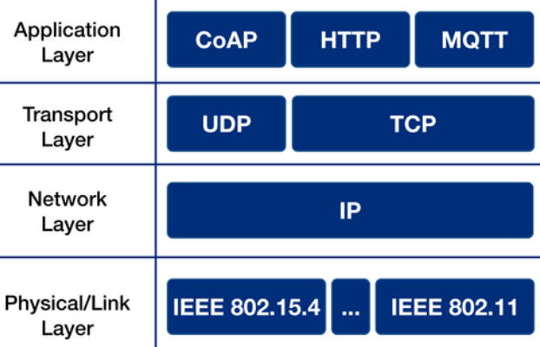
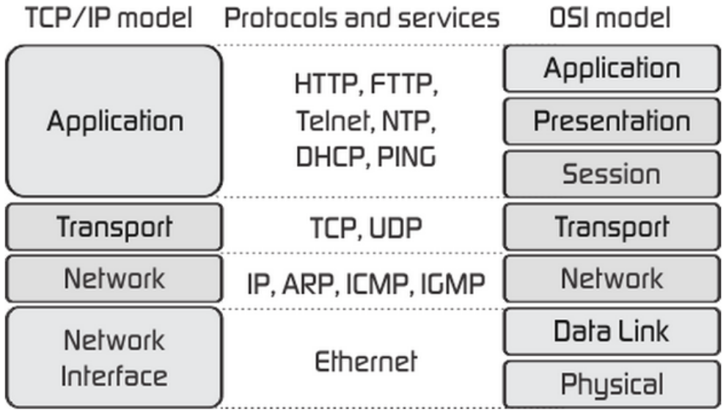
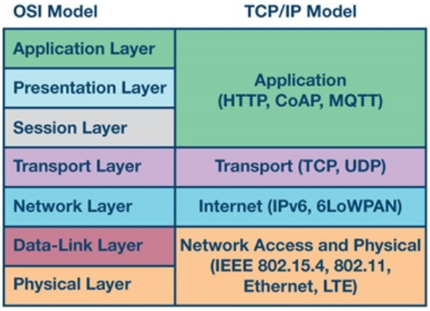
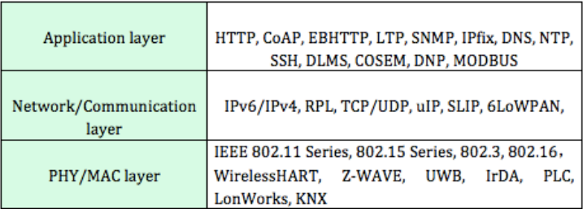
OSI 7 Layer vs TCP/IP
Of the many protocols, wireless protocols play an important role in IoT development.
Wireless Protocols are mainly used in three layers, which are PHY/MAC layer, Network/Communication layer and Application layer.
Notes:
https://mycodecamp.blogspot.com/2019/10/7-layer-of-osi-model.html
https://www.rfwireless-world.com/IoT/IoT-Stack-vs-Web-Stack.html
https://justjii.justdrink.com.tw/tcp-ip%E4%BB%8B%E7%B4%B9/
https://www.cse.wustl.edu/~jain/cse574-14/ftp/coap/

Slide 3
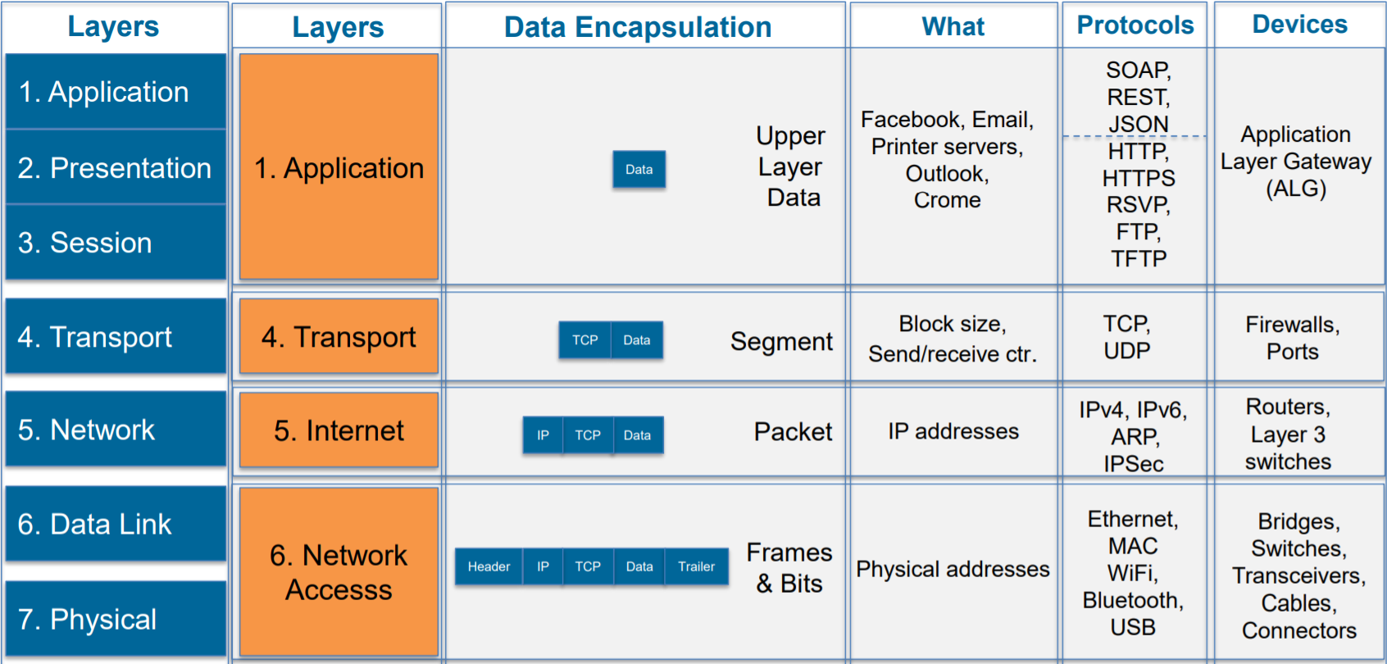
OSI 7 Layer vs TCP/IP

Slide 4
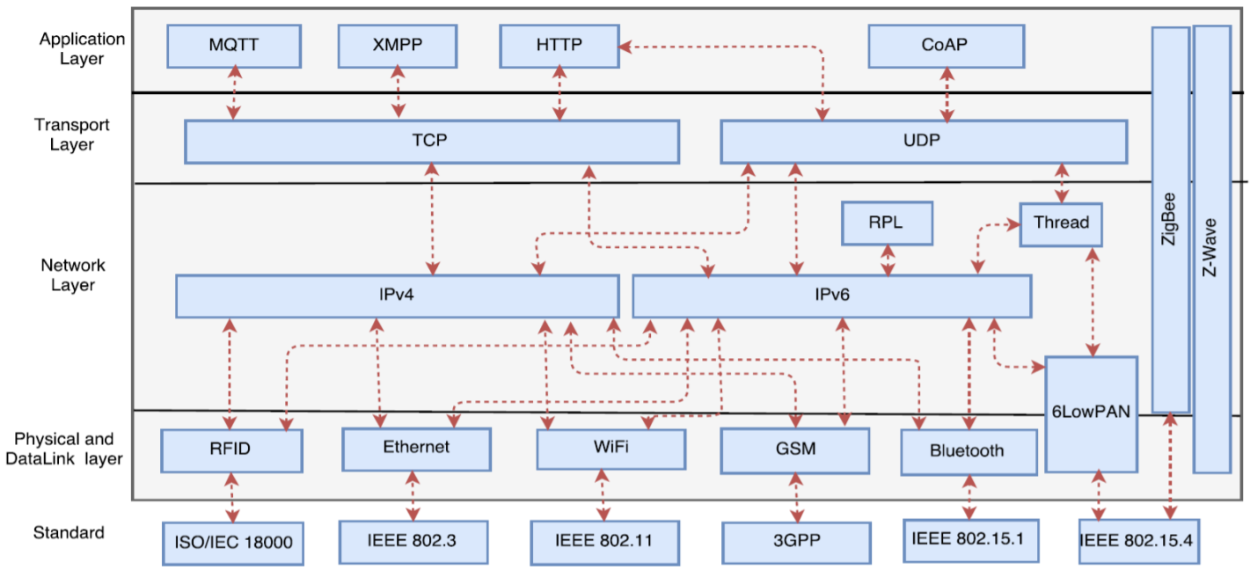
IoT Network Stack and Standards
資料來源 : Journal of Network and Computer Applications

Slide 5
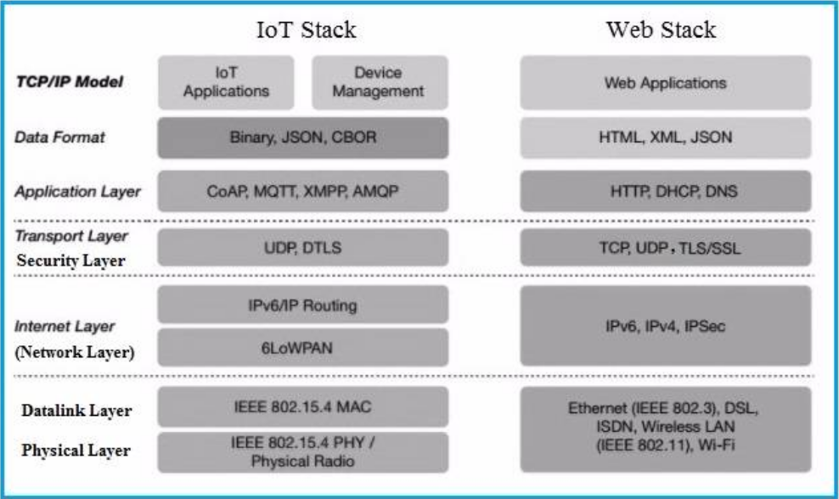
IoT Stack vs Web Stack
資料來源 : https://www.rfwireless-world.com/IoT/IoT-Stack-vs-Web-Stack.html
Notes:
https://www.rfwireless-world.com/IoT/IoT-Stack-vs-Web-Stack.html

Slide 6
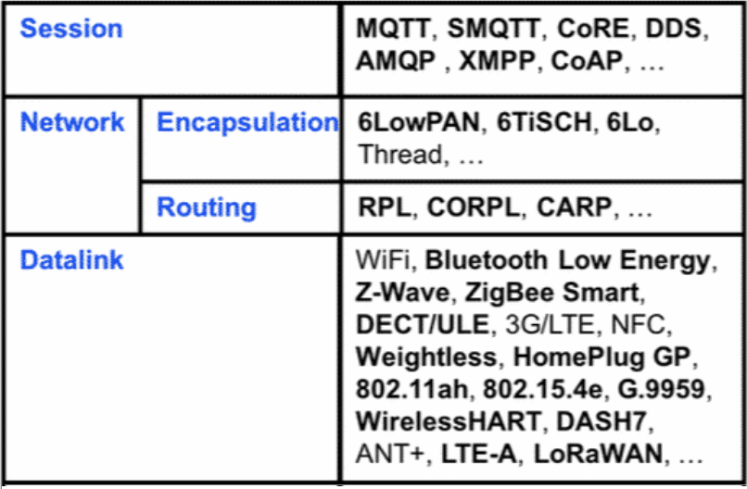
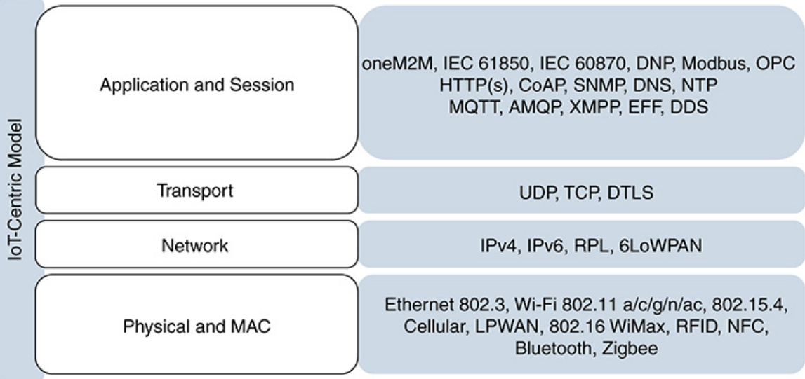
IoT Protocol Stack
資料來源 : https://www.rfwireless-world.com/IoT/IoT-Stack-vs-Web-Stack.html
Notes:
https://www.rfwireless-world.com/IoT/IoT-Stack-vs-Web-Stack.html
http://www.ciscopress.com/articles/article.asp?p=2923211&seqNum=6

Slide 7
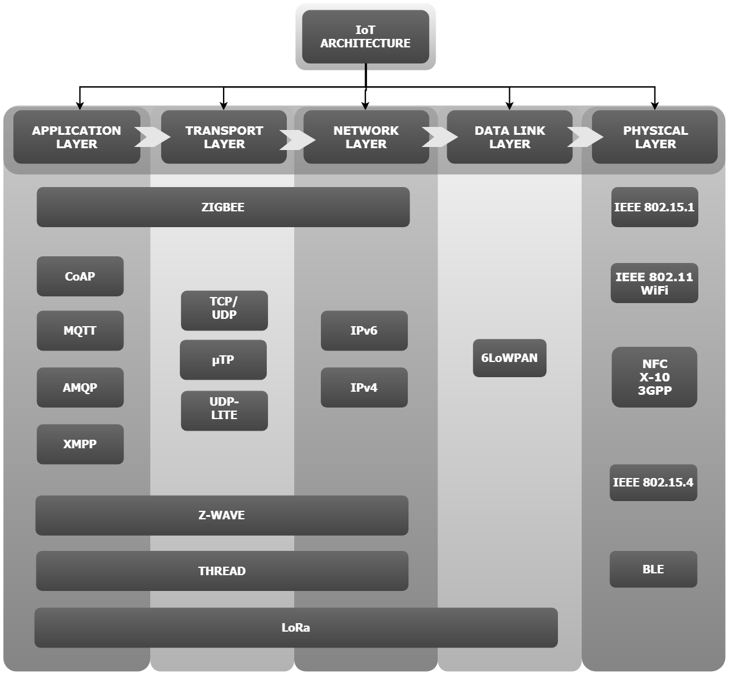
IoT Protocol Stack
資料來源 : https://www.baseapp.com/iot/protocols-for-iot/
Notes:
https://www.baseapp.com/iot/protocols-for-iot/

Slide 8
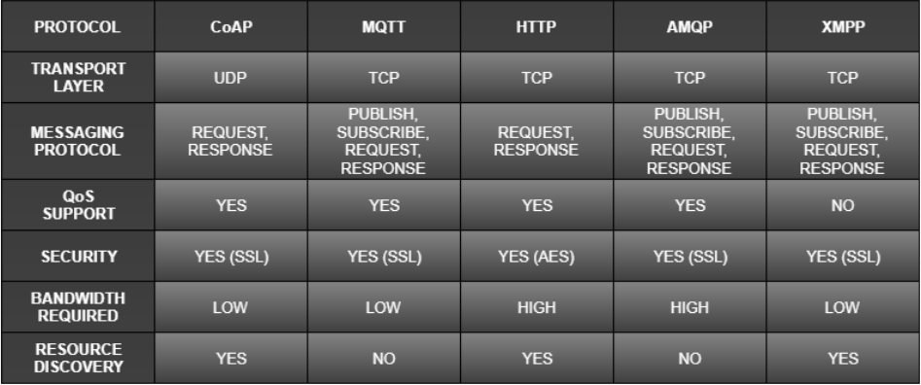
IoT Protocol Comparison
資料來源 : https://www.baseapp.com/iot/protocols-for-iot/
Notes:
https://www.baseapp.com/iot/protocols-for-iot/

Slide 9
MQTT 通訊協定

Slide 10
MQTT 參考網站
MQTT教學
Beginners Guide To The MQTT Protocol
MQTT Brokers/Servers and Cloud Hosting Guide
MQTT Packet Format
MQTT Summary
Development of an MQTT-based IoT Architecture for Energy-Efficient and Low-Cost Applications
Working with the publish-subscribe pattern
Introduction to MQTT
MQTT、CoAP，物聯網兩大實時協議誰主沉浮？
A_Comparison_of_Lightweight_Communication_Protocol
MQTT-SN 協議簡介
ESP8266 HTTP vs MQTT Servers

Slide 11
MQTT 應用實例參考網站
ESP8266 as MQTT Client – Arduino IoT
MQTT遠端遙控
IoT 第一步！Wifi 開關電燈，天馬行空的吹水時間
Rapsberry pi 與 NodeMCU (ESP8266) 溝通 基於 MQTT
ESP8266 as MQTT publisher and subscriber
Introduction to the MQTT Protocol on NodeMCU

Slide 12
MQTT 應用實例
Mosquitto可扮演Broker (Server) :
設定IP Address(192.168.1.xxx)及port=1883
Subscriber指令: mosquitto_sub -d -t message
Publisher指令: mosquitto_pub -d -t message -m "from BrokerName"
CloudMQTT as a server

Slide 13
應用實例 - ESP8266 as MQTT Client – Arduino IoT
CloudMQTT provides MQTT Broker as a service: configure the Server’s name, password and port
In this project we have 3 parts, MQTT Dash (mobile app – MQTT Client as a Publisher), CloudMQTT (MQTT Broker as a service) and ESP8266 Circuit (led control circuit – MQTT Client as a Subscriber). Our mobile app is sending commands to ESP8266 circuit via MQTT broker.
// Create a MQTT Client
// For WiFi interface
WiFiClient espClient;
PubSubClient client(espClient);
// For Ethernet interface
EthernetClient ethClient;
PubSubClient client(ethClient);
// Set the MQTT server
// CloudMQTT need be configured first.
client.setServer(mqtt_server, 17608);
// Set the message callback function
client.setCallback(callback);
(callback : a pointer to a message callback function called when a message arrives for a subscription created by this client.)
const char *ssid = "kevinhinet";
const char *password = "kevin4311";
const char *mqtt_server = "hairdresser.cloudmqtt.com";
const char *device_id = "esp8266";
WiFiClient espClient;
PubSubClient client(espClient);
Void setup()
{
client.setServer(mqtt_server, 17608);
………
}

Slide 14
Creating Account in CloudMQTT – MQTT Broker
Firstly we have to create an account in CloudMQTT.
Enter your email ID at “Create account”, then click on Sign up.
CloudMQTT server will send you the verification mail to the provided email address.
Click on “Get a managed IoT Broker Today” and click on “Get Now” at the last one “Cute Cate”
Enter “Name” for instance to create, example: CloudMQTT.
Click on “Select Region” and next click on “confirm”.
Then click on “Create instance” to complete the instance creation.
After the creation of new instance, we need to note down the instance Name, Server, User, Password and Port details.

Slide 15
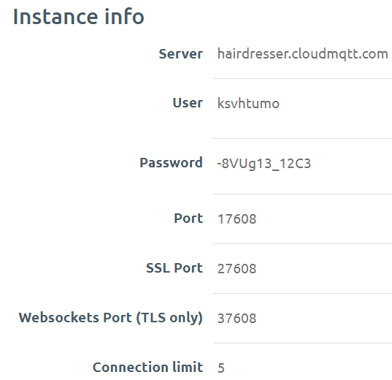
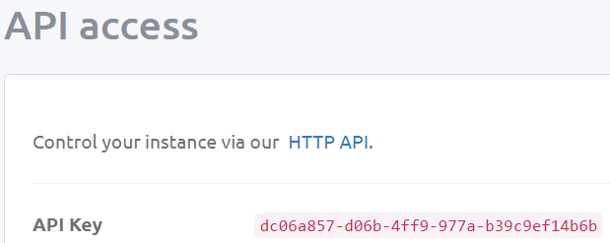
CloudMQTT Instance Information
Server name: hairdresser.cloudmqtt.com
User name: ksvhtumo
Password: -8VUg13_12C3
Port: 17608
API Key: dc06a857-d06b-4ff9-977a-b39c9ef14b6b
Notes:
https://api.cloudmqtt.com/console/82658482/details

Slide 16
MQTT Client APP
MQTT.fx For Desktop
MQTT Dash for Android
MQTTool for iOS
IoT OnOff for Android and iOS

Slide 17
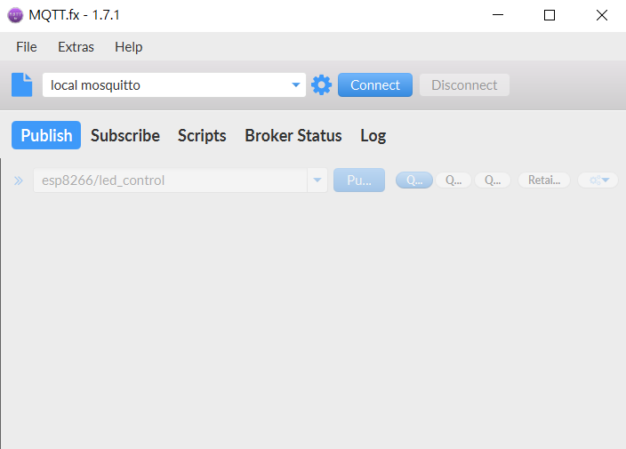
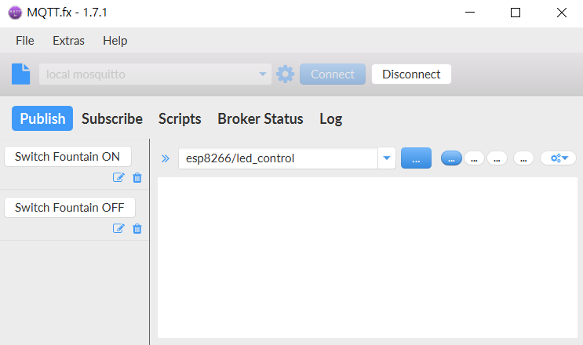
MQTT.fx For Desktop
Cloudmqtt broker setting:
Server name: hairdresser.cloudmqtt.com
User name: ksvhtumo
Password: -8VUg13_12C3
Port: 17608
API Key: dc06a857-d06b-4ff9-977a-b39c9ef14b6b
Notes:
資料來源 : https://mqttfx.jensd.de/index.php/download

Slide 18
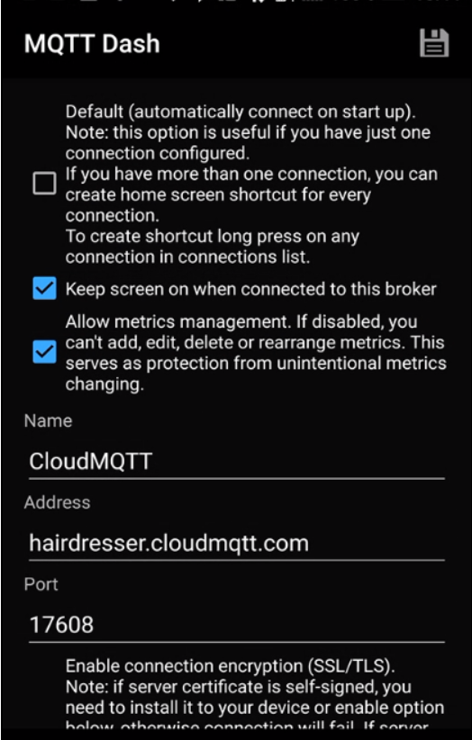
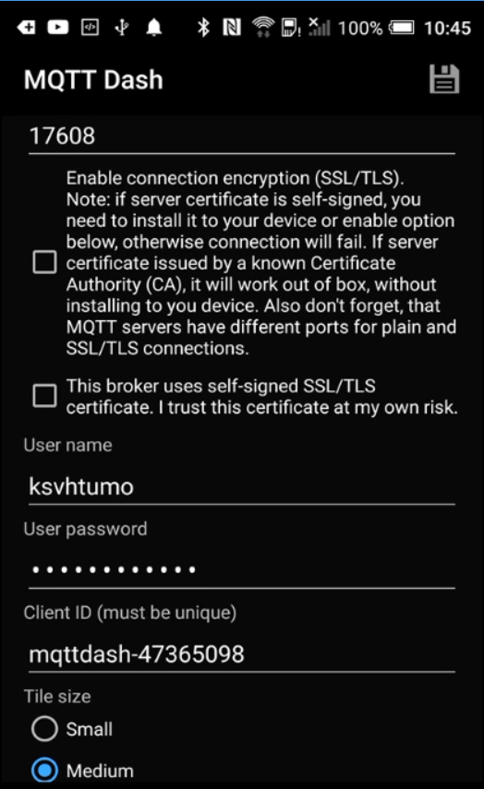
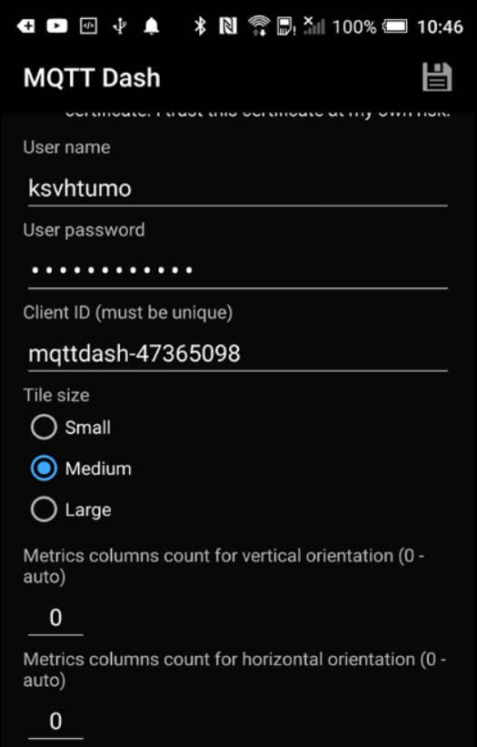
MQTT Dash App 設定
Notes:
參考網站 : http://blog.magicblocks.io/2017/06/lesson-18-mqtt-dash-mobile-app-with.html

Slide 19
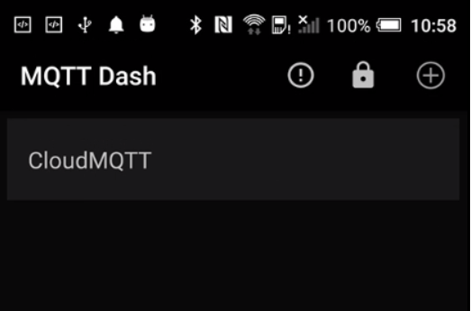
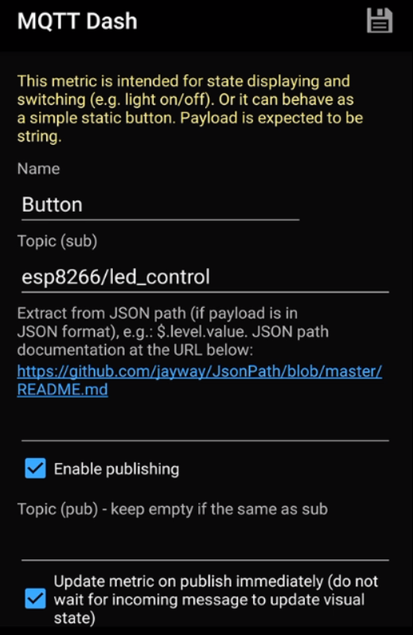
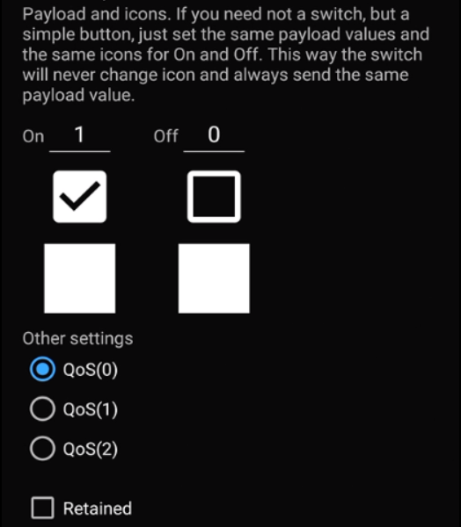
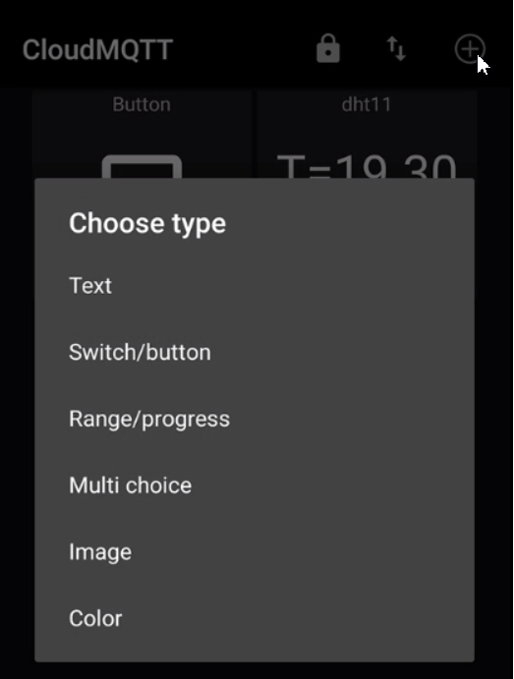
MQTT Dash App 設定 – Switch/Button
Topic名稱要配合程式中的設定

Slide 20
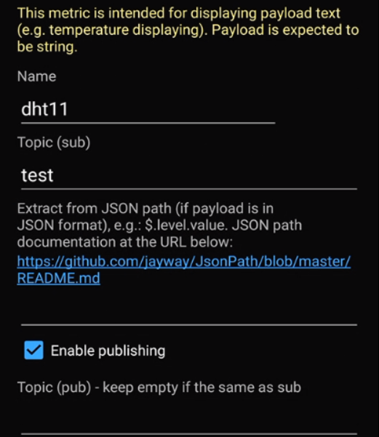
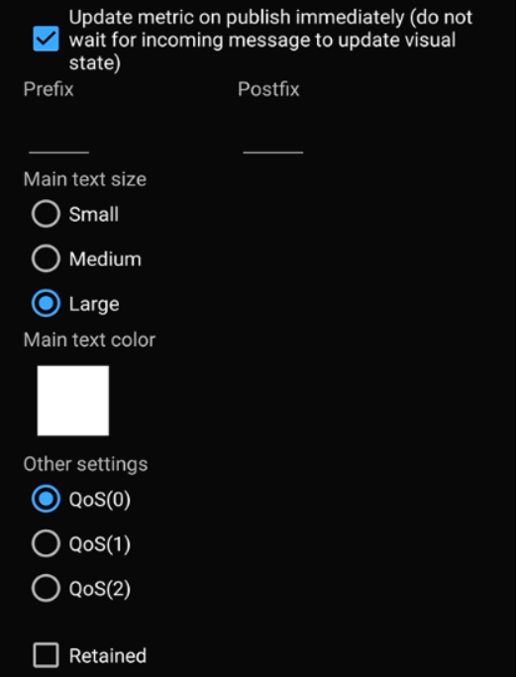
MQTT Dash App 設定 - Text
可依要顯示的訊息多寡調整文字大小
Topic名稱要配合程式中的設定

Slide 21
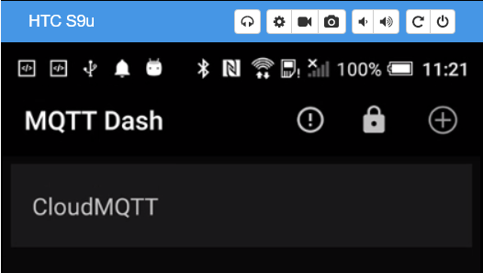
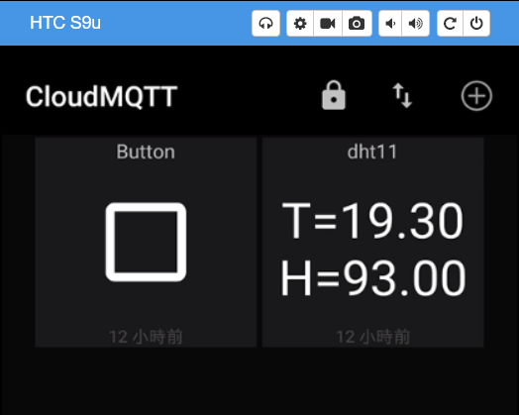
MQTT Dash App 設定
Button
Topic:esp8266/led_control
Text
Topic:test

Slide 22
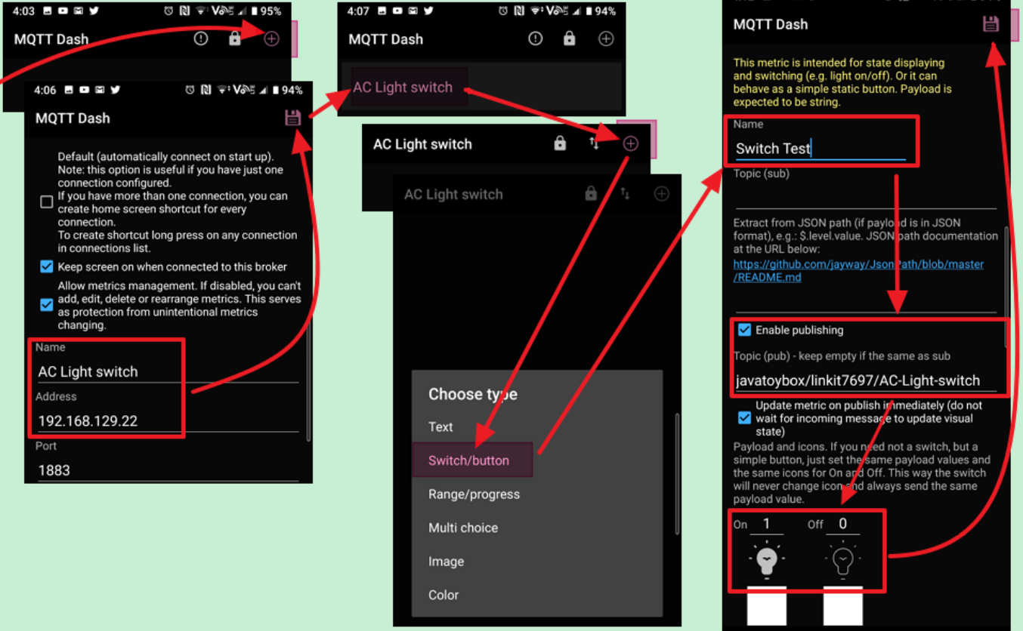
MQTT Dash App 設定
Notes:
https://javatoybox.blogspot.com/2019/08/iot-wifi-3.html

Slide 23
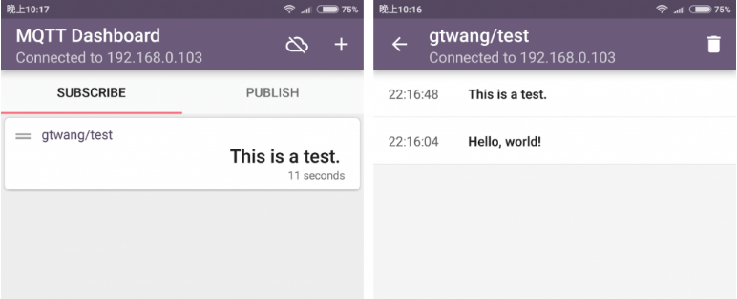
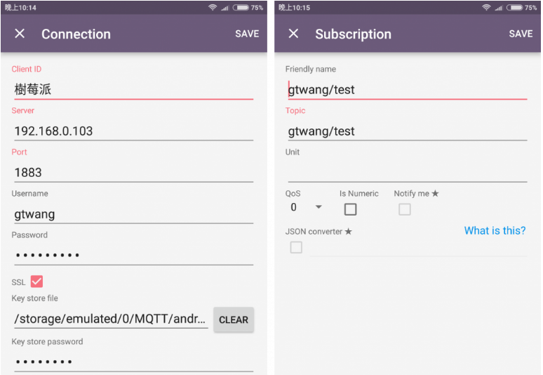
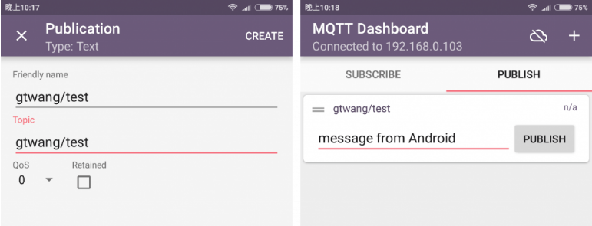
IoT MQTT Dashboard App設定
Notes:
https://blog.gtwang.org/iot/raspberry-pi/raspberry-pi-mosquitto-mqtt-broker-iot-integration/2/

Slide 24
MQTT 簡介
MQTT是由IBM的Andy Stanford-Clark博士和Arcom（已更名為Eurotech）的Arlen Nipper博士於1999年發明的通訊協定。他們當時是為了在狹窄的網路頻寬和微小電力損耗的需求前提之下，提供石油管線感測器和人造衛星之間一個輕量、可靠的二進制通訊協定
MQTT和HTTP的底層都是TCP/IP，也就是物聯網裝置可以沿用既有的網路架構和設備，只是在網路上流通的「訊息格式」以及應用程式的處理機制不同。
MQTT是一種基於「發布∕訂閱」機制的訊息傳輸協定（MQTT is a Client Server publish/subscribe messaging transport protocol），我們可以把它想成雜誌發行和訂閱的機制。MQTT訊息發送端，相當於雜誌出版社，雜誌出版之後並不直接寄給消費者，而是交給經銷商或者書店一般的代理人（broker），來統籌管理發行和訂閱事宜。每一個訊息來源（刊物）都有個唯一的主題名稱（刊物名稱）。代理人是個伺服器軟體，向伺服器發送主題的一方是發布者（publisher），從伺服器獲取主題的一方則是訂閱者（subscriber）。
MQTT clients include both publishers and subscribers. All the clients need a single server (called a broker in MQTT parlance) in order to pass messages between them.
Notes:
資料來源 : https://swf.com.tw/?p=1002
Understanding callbacks: https://subscription.packtpub.com/book/application_development/9781787287815/3/ch03lvl1sec41/understanding-callbacks

Slide 25
What is the client id and where do I find it?
The short answer is that the client id is chosen by you. Often it’s not even necessary to specify a client id because the client library will use a randomly generated if it’s not given explicitly.
However, it can be good to chose client id wisely to make it easier to setup ACL rules and to make the broker log easier to read. It’s also good to have client ids one remembers, e.g. Johns-phone or customer-12345.
When a client subscribes to a topic, the subscription is associated with the client id and not the connection or username. When a messages is published to a topic, the broker will iterate over all subscriptions matching the topic and look up if any connection is active with the associated client id. If a connections i found, the message will be published to the currently connected device. If the subscription is done with QoS 1 or 2, and the message are published with at least QoS 1 the message will be retained in the broker and delivered next time a client with the right client id connects.
When a device connects and there is another connection with the same client id, the latter will be disconnected. This is because the broker will assume that the old connection has died and devices is just reconnecting.
Notes:
資料來源 https://www.cloudmqtt.com/blog/2018-11-21-mqtt-what-is-client-id.html

Slide 26
Understanding callbacks
When we declare a function, we pass this function as an argument to another function or method, or we assign this function to an attribute, and then some code calls this function at some time; this mechanism is known as callback. The name callback is used because the code calls back a function at some time.
The code declares three functions that we will specify as callbacks:
on_connect: This function will be called when the MQTT client receives a CONNACK response from the MQTT server, that is, when a connection has been successfully established with the MQTT server.
on_subscribe: This function will be called when the MQTT client receives a SUBACK response from the MQTT server, that is, when a subscription has been successfully completed.
on_message: This function will be called when the MQTT client receives a PUBLISH message from the MQTT server. Whenever the MQTT server publishes a message, based on the subscriptions for the client, this function will be called.
If the client is used to subscribe to topics, a callback function must be provided in the constructor. This function is called when new messages arrive at the client.
Notes:
資料來源 https://subscription.packtpub.com/book/application_development/9781787287815/3/ch03lvl1sec41/understanding-callbacks

Slide 27
Understanding callbacks
The callback function has the following signature:
void callback(const char[] topic, byte* payload, unsigned int length);
Parameters
topic - the topic the message arrived on (const char[])
payload - the message payload (byte array)
length - the length of the message payload (unsigned int)
Notes:
資料來源 https://subscription.packtpub.com/book/application_development/9781787287815/3/ch03lvl1sec41/understanding-callbacks

Slide 28
Understanding callbacks
Callbacks are functions that are called in response to an event.
Event Connection acknowledged Triggers the on_connect callback
Event Disconnection acknowledged Triggers the on_disconnect callback
Event Subscription acknowledged Triggers the on_subscribe callback
Event Un-subscription acknowledged Triggers the on_unsubscribe callback
Event Publish acknowledged Triggers the on_publish callback
Event Message Received Triggers the on_message callback
Event Log information available Triggers the on_log callback
To use a callback you need to do two things
Create the callback function
Assign the function to the callback.
Notes:
資料來源 http://www.steves-internet-guide.com/mqtt-python-callbacks/

Slide 29
Callbacks with two topics
void callback(char* topic, byte* payload, unsigned int length) { payload[length] = '\0'; // String strPayload = String((char*)payload); String strTopic = String((char*)topic); if(strcmp(topic, "audio/home/bedroom/title") == 0) { // found a title msg = (char*)payload; writetitle = msg; titlelength = length; // not yet used this scrollcounter = 100; // this resets the scroll counter so it pauses before scrolling x_pos = 3; // set scroll position to left Serial.println("Found a title update"); } if(strcmp(topic, "audio/home/bedroom/vol") == 0) { // found a volume msg = (char*)payload; writevol = msg; Serial.println("Found a volume command"); } }
Notes:
資料來源 https://forum.arduino.cc/index.php?topic=266167.0

Slide 30
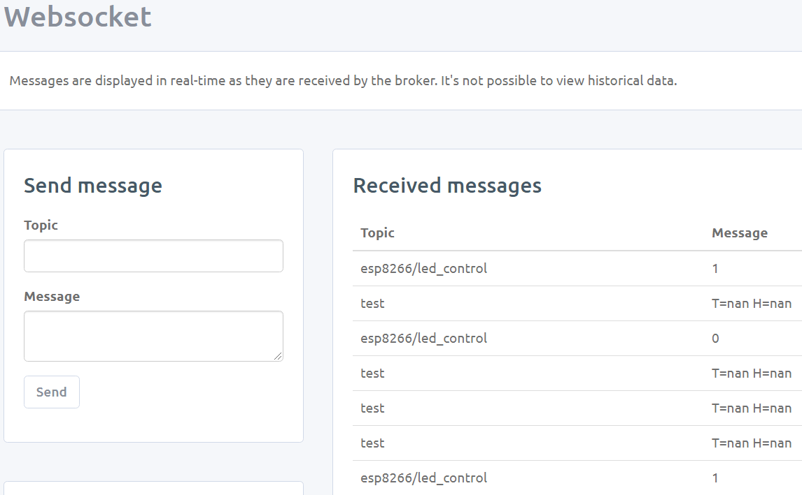
Callbacks with two topics
CloudMQTT server 畫面
二個不同的Topic

Slide 31
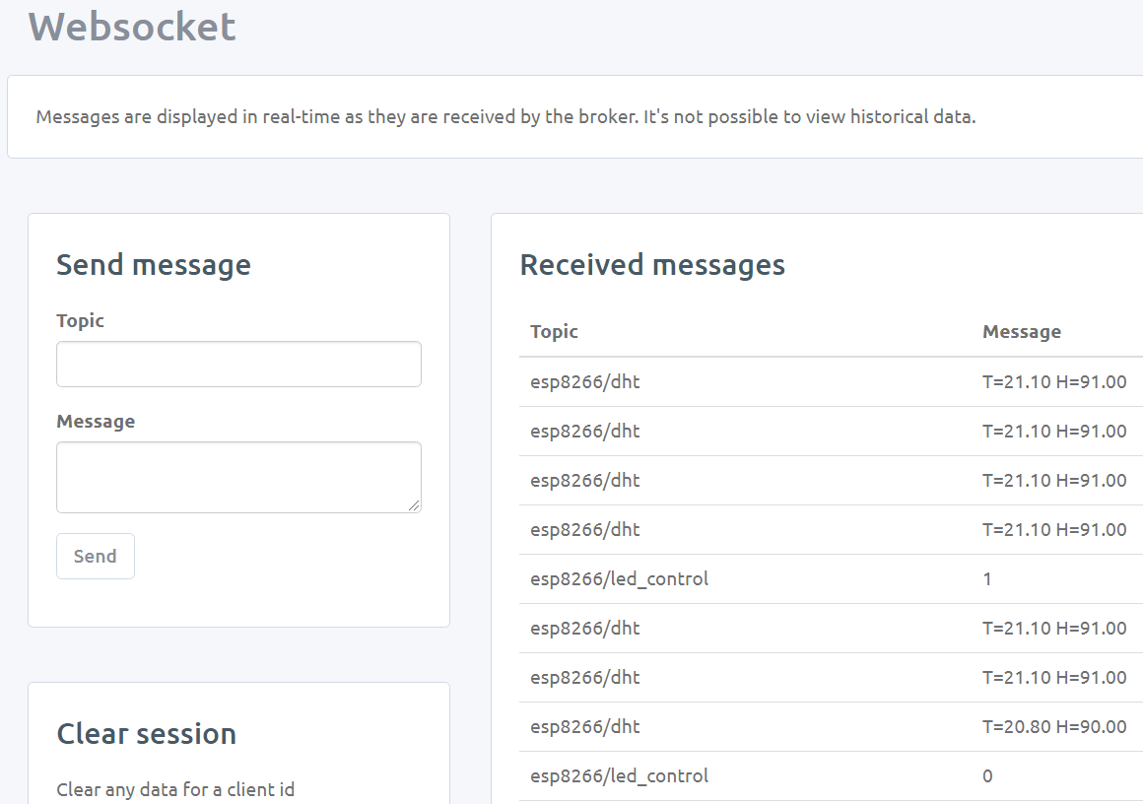
Callbacks with two topics
CloudMQTT server 畫面
二個不同的Topic

Slide 32
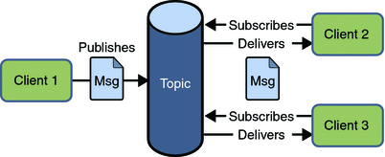
Introduction to MQTT
Important facts to note in the left diagram are that:
Information streams are known as topics
A client can publish data to a topic. There can be more than one publisher per topic
Multiple clients can subscribe to a topic
A Broker in the middle facilitates the brokering or relaying of the messages.
資料來源 : magicblocks.io
MQTT defines several methods to indicate desired actions during communication Connect
Waits for a connection to be established with the server.
Disconnect
Waits for the MQTT client to finish any work it must do, and for the TCP/IP session to disconnect.
Subscribe
Waits for completion of the Subscribe or UnSubscribe method.
Notes:
資料來源: http://blog.magicblocks.io/2017/06/lesson-18-mqtt-dash-mobile-app-with.html

Slide 33
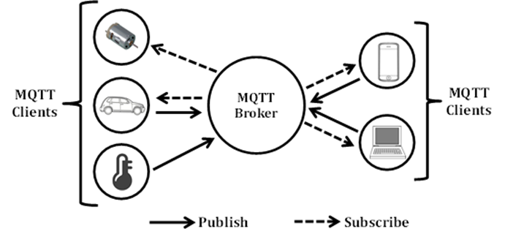
MQTT Architecture – Publish/Subscribe (Client/Broker)
In this model, the MQTT clients (IoT nodes) either publish or subscribe (or both) to topics in the MQTT broker. Typically, a sensor or monitoring node publishes its data to a specific topic in a particular broker via the Internet (the publisher can create the topic at the same time it is sending data) while an actuator or control node simply subscribes to an appropriate topic (or topics) in the same broker (also via the Internet). Users can also publish and subscribe to topics in the same broker using their Internet connected PCs or smartphones in order to remotely control actuators and monitor sensor data, respectively.

Slide 34
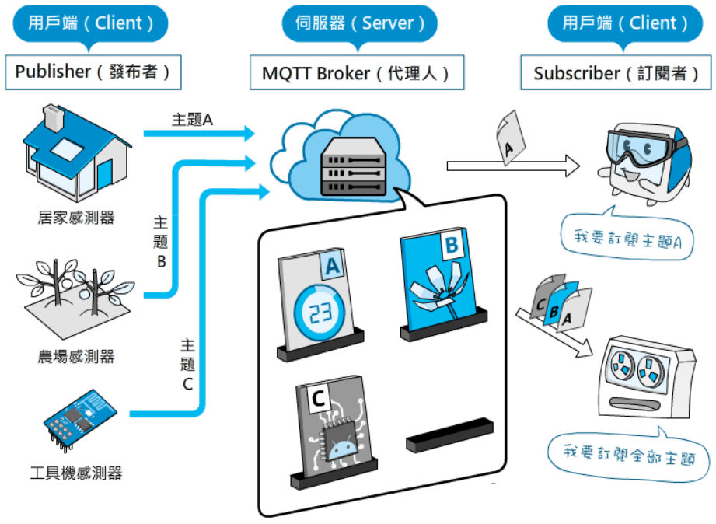
MQTT 的Publisher, Broker和Subscriber
資料來源 : https://swf.com.tw/?p=1002
Notes:
資料來源 : https://swf.com.tw/?p=1002

Slide 35
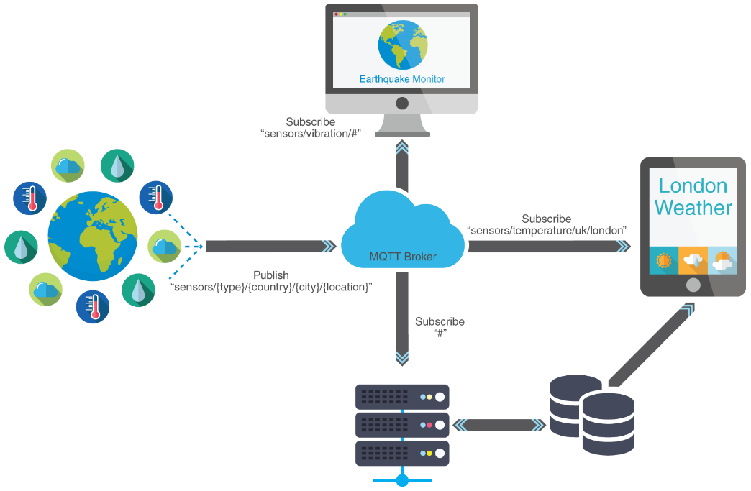
Introduction to the MQTT Protocol on NodeMCU
資料來源: https://www.allaboutcircuits.com/projects/introduction-to-the-mqtt-protocol-on-nodemcu/
Notes:
資料來源: https://www.allaboutcircuits.com/projects/introduction-to-the-mqtt-protocol-on-nodemcu/

Slide 36
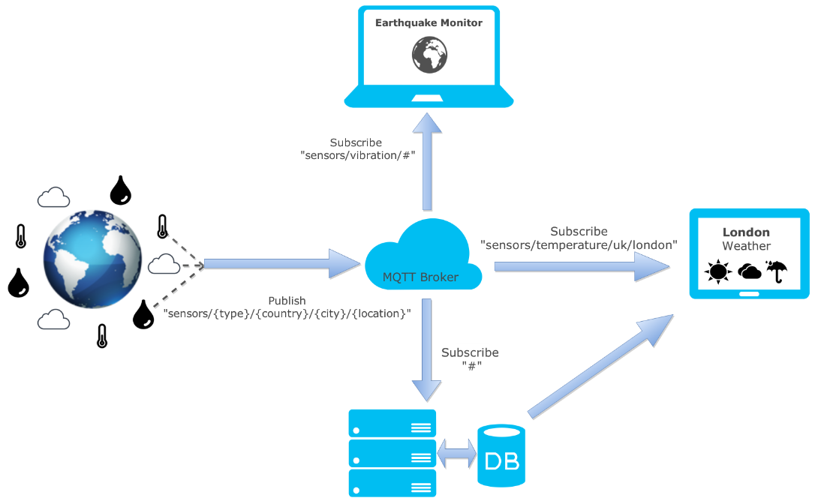
Introduction to the MQTT Protocol on NodeMCU
資料來源: https://zoetrope.io/tech-blog/brief-practical-introduction-mqtt-protocol-and-its-application-iot/
Notes:
資料來源: https://zoetrope.io/tech-blog/brief-practical-introduction-mqtt-protocol-and-its-application-iot/

Slide 37
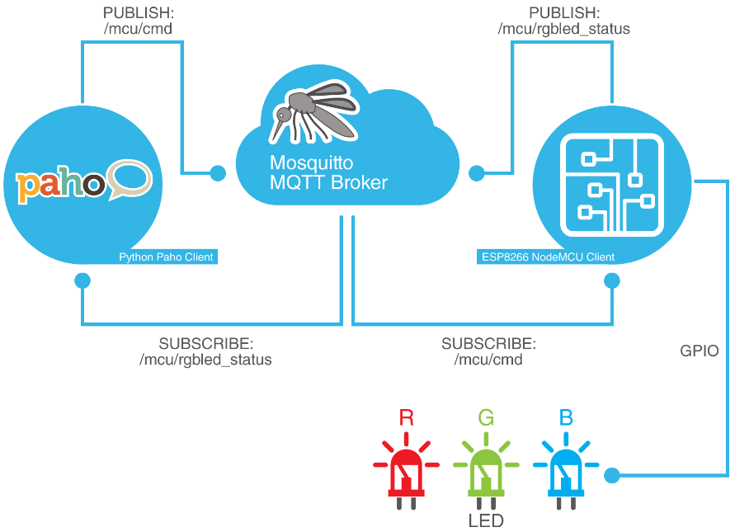
Introduction to the MQTT Protocol on NodeMCU
資料來源: https://www.allaboutcircuits.com/projects/introduction-to-the-mqtt-protocol-on-nodemcu/
Notes:
資料來源: https://www.allaboutcircuits.com/projects/introduction-to-the-mqtt-protocol-on-nodemcu/

Slide 38
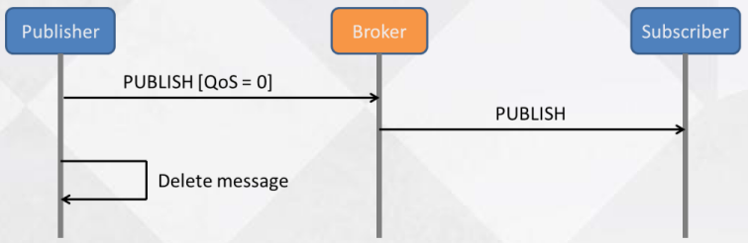
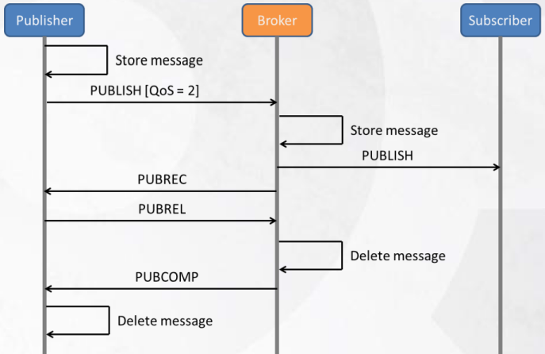
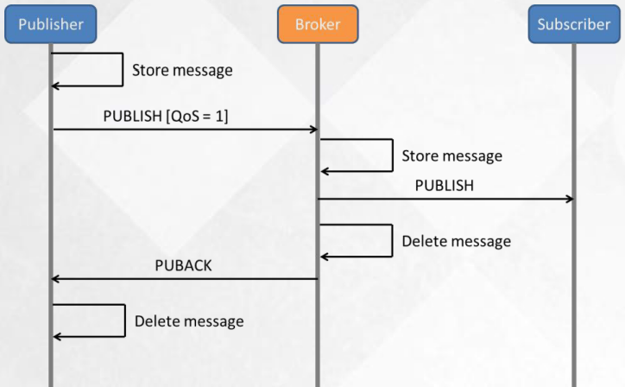
MQTT 的三種QoS
Notes:
資料來源 : https://thinkingiot.blogspot.com/2016/08/mqtt-vs-coap-or-others.html

Slide 39
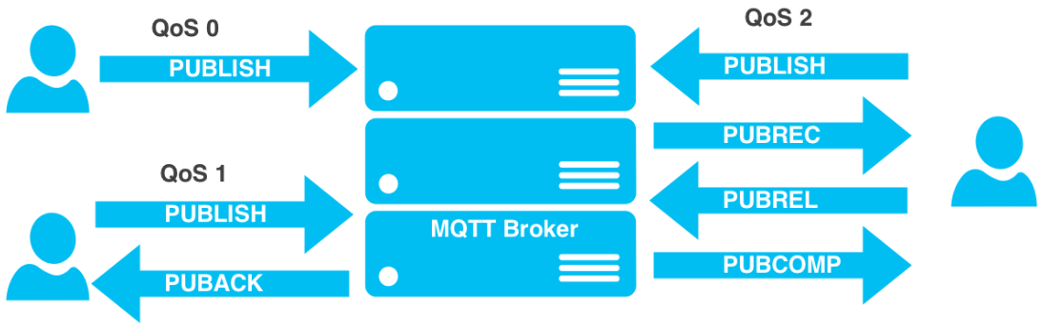
MQTT 的三種QoS
資料來源: https://zoetrope.io/tech-blog/brief-practical-introduction-mqtt-protocol-and-its-application-iot/
Notes:
資料來源: https://zoetrope.io/tech-blog/brief-practical-introduction-mqtt-protocol-and-its-application-iot/

Slide 40
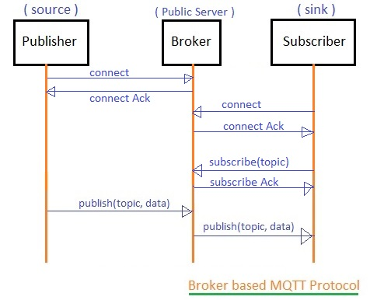
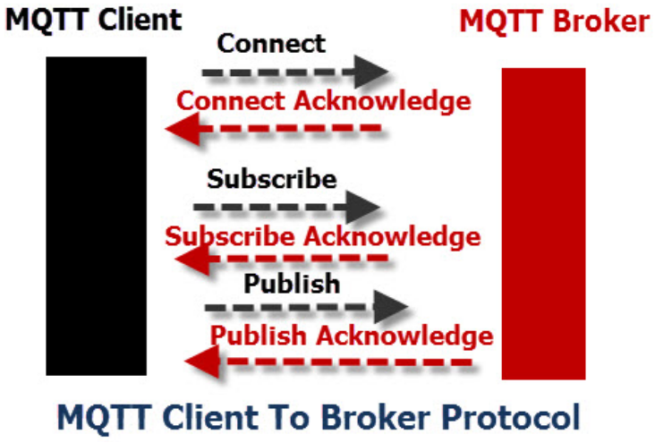
MQTT Client to Broker Process
MQTT is a binary-based protocol and has command and command acknowledgement format. So every time a client sends a command to the broker, the broker sends an acknowledgement.
This communication protocol is actually based on the TCP/IP protocol. So first there will be a TCP connection establishment and then there will be MQTT connection establishment and then the data transfer will occur. After which TCP connection will be terminated.
資料來源 : http://www.steves-internet-guide.com/mqtt-protocol-messages-overview/

Slide 41
When a client has to publish a message
The client has to establish a connection to the broker by sending a connect packet (With username and password if needed)
Wait for the acknowledgement to see if the connection is accomplished or if there is an error.
The client will send a publish packet which will contain the topic name and message to be published.
wait for the publish response packet depending on the QoS level. QoS 0: There won’t be any response QoS 1: PUBACK – Publish acknowledgement response QoS 2 :
wait for PUBREC – Publish received.
send back PUBREL – Publish release.
wait for PUBCOMP – Publish complete.
If the communication is complete. The client can disconnect from the broker by sending a disconnect packet.

Slide 42
When a client has to subscribe a message
Send a Connect packet to the broker (With username and password if needed)
Wait for the Connect acknowledgement packet from the broker to see if the connection is accomplished or if there is an error.
And when Connect acknowledgement is received, send the subscribe packet with the appropriate topic name.
Wait for the subscribe acknowledgement packet.

Slide 43
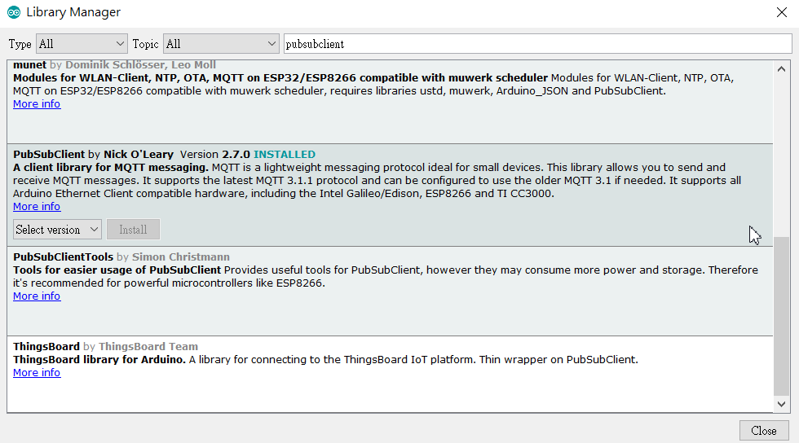
PubSubClient Library
There are quite a number of Arduino-compatible MQTT clients available now. One of the best-known is PubSubClient, which works very well and is simple to use.
Add PubSubClient Library from
Arduino IDE Library Manager and
Search “PubSubClient” and select
PubSubClient by Nick O’Leary

Slide 44
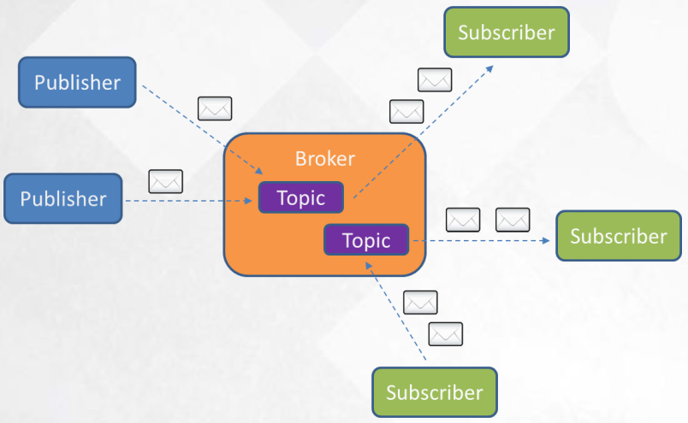
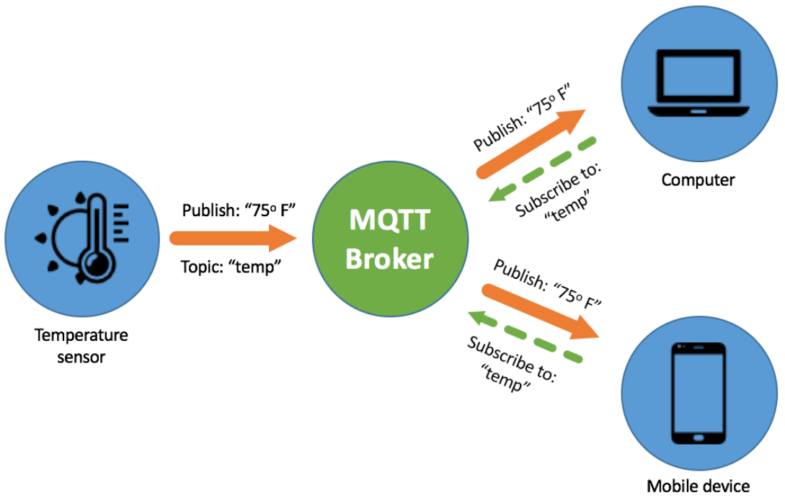
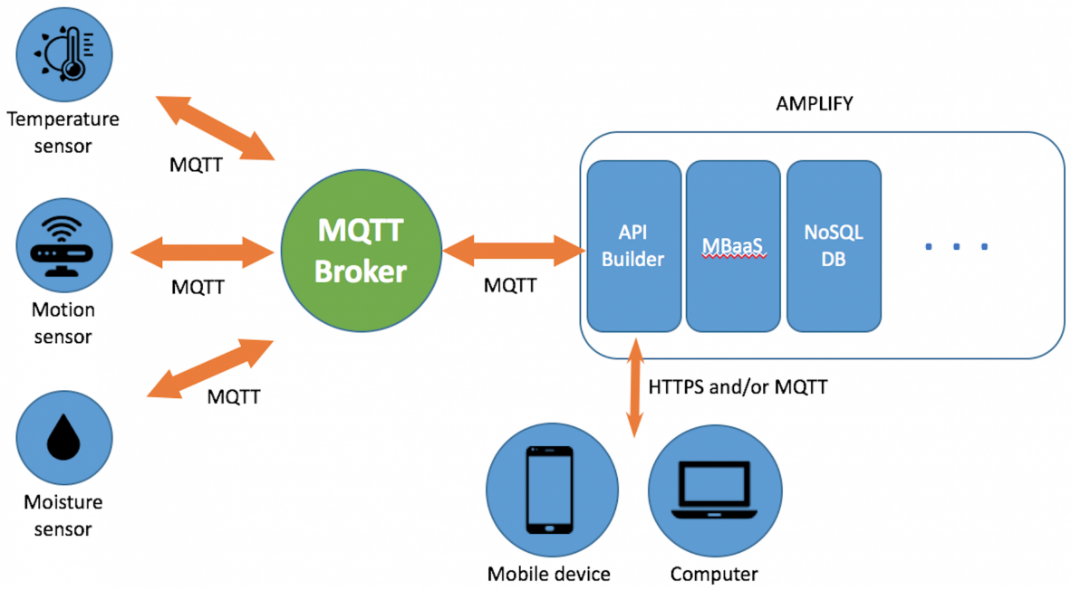
資料來源 : https://devblog.axway.com/apis/api-builder-and-mqtt-for-iot-part-1/
Notes:
https://devblog.axway.com/apis/api-builder-and-mqtt-for-iot-part-1/
資料來源 : https://thinkingiot.blogspot.com/2016/08/mqtt-vs-coap-or-others.html

Slide 45
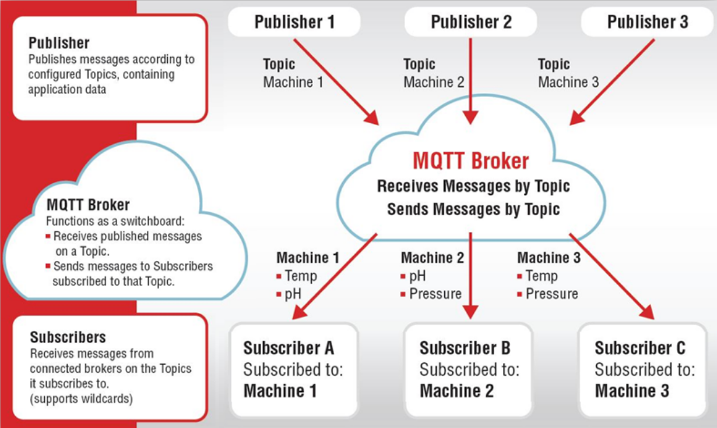
資料來源 : https://unitronicsplc.com/Download/SoftwareHelp/UniLogic_Knowledgebase/Communications/MQTT.htm
Notes:
https://unitronicsplc.com/Download/SoftwareHelp/UniLogic_Knowledgebase/Communications/MQTT.htm

Slide 46
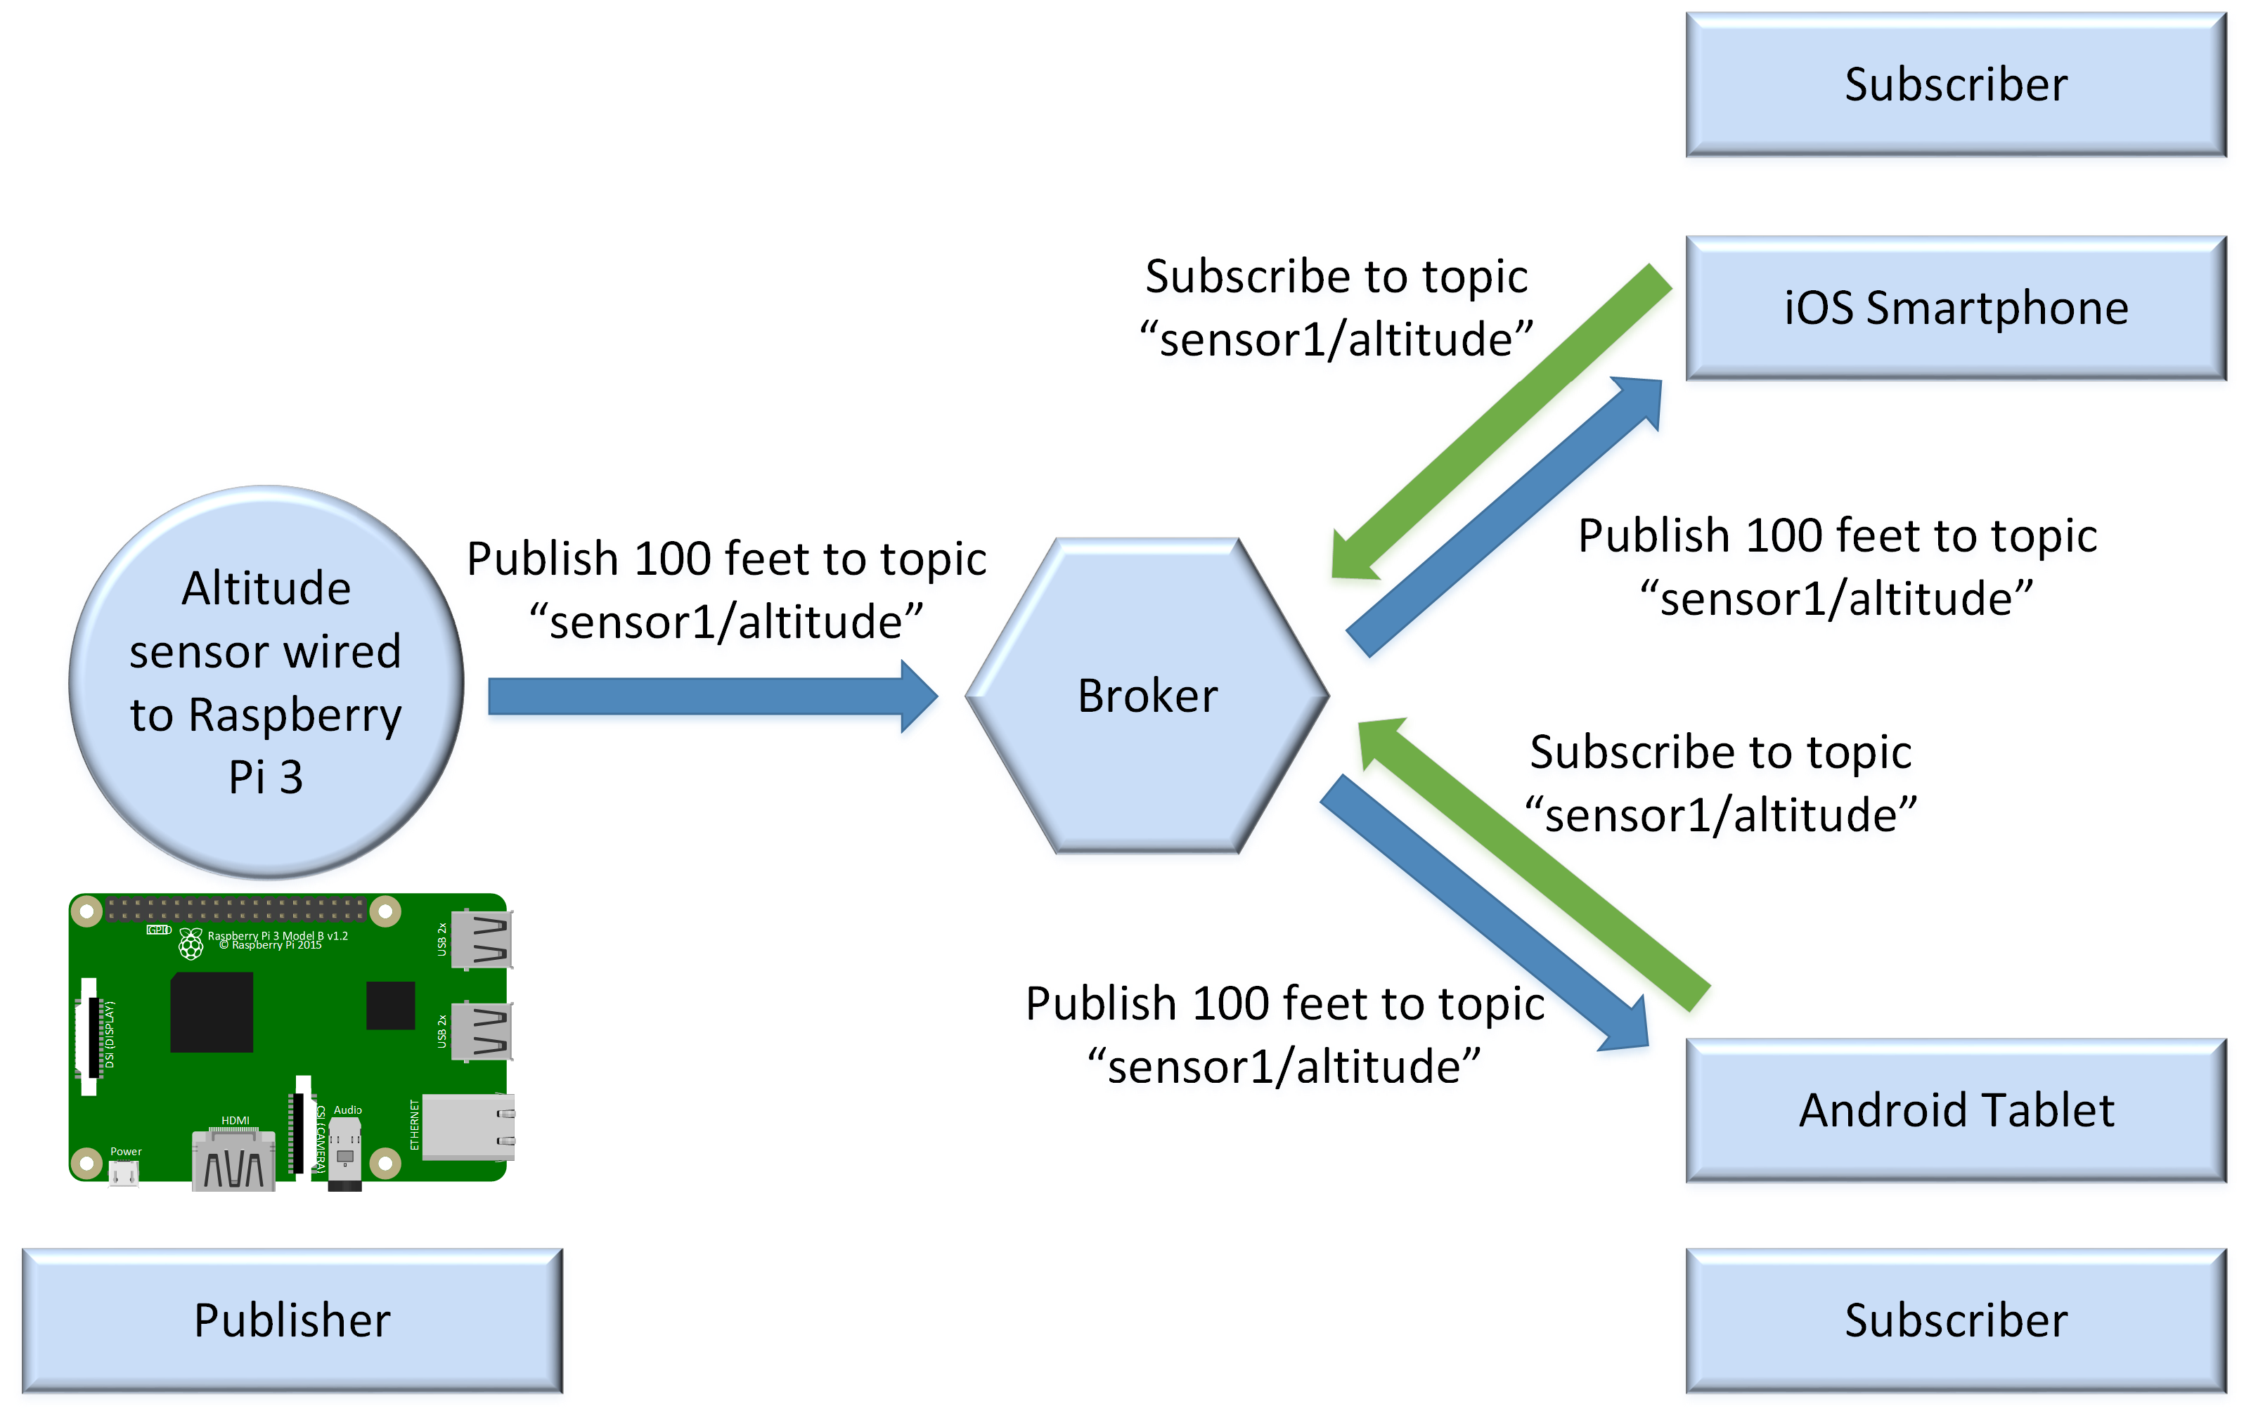
A topic is a named logical channel and it is also referred to as a channel or subject. The broker will send publishers only the messages published to topics to which they are subscribed.
The data for a message is known as payload. A message includes the topic to which it belongs and the payload.
資料來源 : https://www.embedded.com/mqtt-essentials-scenarios-and-the-pub-sub-pattern/
Notes:
https://www.embedded.com/mqtt-essentials-scenarios-and-the-pub-sub-pattern/
The publish-subscribe pattern requires a broker, also known as server. All the clients establish a connection with the broker. The client that sends a message through the broker is known as the publisher. The broker filters the incoming messages and distributes them to the clients that are interested in the type of received messages. The clients that register to the broker as interested in specific types of messages are known as subscribers. Hence, both publishers and subscribers establish a connection with the broker.

Slide 47

Typical message flow in MQTT
資料來源 : Rathi 2017

Slide 48


MQTT Packet Format
資料來源 : http://www.steves-internet-guide.com/mqtt-protocol-messages-overview/

Slide 49

MQTT Packet Structures
資料來源 : http://www.steves-internet-guide.com/mqtt-protocol-messages-overview/

Slide 50

MQTT outperforms HTTPS when sending 1024 1-byte messages to a mobile.
資料來源 : Nicholas 2012

Slide 51


MQTT Header
Fixed Header
資料來源 : MQTT_V3.1_Protocol_Specific.pdf
Variable Header

Slide 52


Message delivery at different QoS levels
資料來源 : Source: Patierno 2014
資料來源 : http://www.steves-internet-guide.com/mqtt-publish-subscribe/
Notes:
http://www.steves-internet-guide.com/mqtt-publish-subscribe/

Slide 53

WiFi – DHCP – MQTT Initialization
Notes:
https://github.com/mrizvic/nodemcu-uart2mqtt/

Slide 54

Home Automation based on MQTT using JAVA client
In this project, we are using MQTT protocol for home automation which is to be control remotely without human presence (without human input). Node MCU wifi module is connected to MQTT broker acting as a MQTT client. Java based another client acting as a controlling unit.
Package includes:
Node MCU
Sensor board
led board
Power supply
USB to Micro Cable
Connectors
CD with complete documentation, software's required,libraries,video,Osmosis Platform account creation documents
Notes:
http://axelta.com/Home_Automation_MQTT.php

Slide 55

Home Automation based on MQTT using JAVA client
Technologies Used
MQTT - Message Queuing Telemetry Transport
IoT - Internet of Things
JAVA with Eclipse Paho
Wifi
Software used
Arduino IDE - for Arduino and NodeMCU programming
MQTT Lens
OSMOSIS MQTT Broker
AWS
Eclipse
Hardware used
Node MCU
Sensor board
led board
Notes:
http://axelta.com/Home_Automation_MQTT.php

Slide 56

Quality of Service for reliable messaging
資料來源: https://www.myoschain.com/blog/140400808016478208
Notes:
資料來源: https://www.myoschain.com/blog/140400808016478208

Slide 57

Notes:
資料來源: https://www.myoschain.com/blog/140400808016478208

Slide 58


Mobile app navigation map
Mobile application screenshots:
Notes:
https://www.mdpi.com/2071-1050/11/20/5777/htm#sec2dot1-sustainability-11-05777

Slide 59


Slide 60




Slide 61



Slide 62
MQTT-SN 通訊協定

Slide 63
MQTT-SN 參考網站
A_Comparison_of_Lightweight_Communication_Protocol
MQTT-SN 協議簡介
Introduction to MQTT-SN (MQTT for Sensor Networks)

Slide 64
MQTT-SN 簡介
Unlike MQTT, MQTT-SN can use UDP as the transport protocol although the specification does not limit the protocol to be used only on UDP. The advantage of using UDP is removing the handshakes of TCP and made the communication connectionless thus making it more lightweight.
Even though MQTT is designed to be lightweight, it has two drawbacks for very constrained devices.
Every MQTT client must support TCP and will typically hold a connection open to the broker at all times. For some environments where packet loss is high or computing resources are scarce, this is a problem.
MQTT topic names are often long strings which make them impractical for 802.15.4.
Both of these shortcomings are addressed by the MQTT-SN protocol, which defines a UDP mapping of MQTT and adds broker support for indexing topic names.
Notes:
資料來源 : https://www.sciencedirect.com/science/article/pii/S1877050915038193
A_Comparison_of_Lightweight_Communication_Protocol.pdf
https://kknews.cc/zh-tw/news/22k6bmg.html
https://www.eclipse.org/community/eclipse_newsletter/2014/february/article2.php

Slide 65
MQTT-SN vs MQTT
The main differences involve reducing the size of the message payload and removing the need for a permanent connection by using UDP as the transport protocol.
The MQTT-SN specification lists these differences.
Connect message split into three messages two are optional and are used for the will message
Topic id’s used in place of topic names.
Short Topic names
Pre-defined topics.
Discovery process to let clients discover the Gateway
Will Topic and messages can be changes during the session
Offline keep alive procedure for sleeping clients.
Notes:
資料來源 : http://www.steves-internet-guide.com/mqtt-sn/

Slide 66

MQTT-SN Architecture
The specification lists three components:
MQTT-SN client
MQTT-SN Gateway
MQTT-SN forwarder.
Notes:
資料來源: http://www.steves-internet-guide.com/mqtt-sn/

Slide 67
CoAP 通訊協定

Slide 68
CoAP 參考網站
CoAP – Constrained Application Protocol
Constrained Application Protocol for Internet of Things
RFC7252 The Constrained Application Protocol (CoAP)
MQTT、CoAP，物聯網兩大實時協議誰主沉浮？
A_Comparison_of_Lightweight_Communication_Protocol
Coap-node
一步步搭建物聯網系統——RESTful的CoAP協議
Constrained RESTful Environments (core)

Slide 69
CoAP 應用參考網站
coap-node
一步步搭建物聯網系統——RESTful的CoAP協議
CoAP-simple-library for Arduino IDE
microcoap for Arduino
ESP-CoAP
Publish an Event with ESP8266 to Wia via CoAP API
COAP on ESP8266 (http://www.ikanbilis.com/362.php)
ESP8266 Triple Protocol Server
ESP8266 as a CoAP Client

Slide 70
CoAP 簡介
CoAP is designed to enable simple, constrained devices to join the IoT even through constrained networks with low bandwidth and low availability.
In a network with a lot of congestion or limited connectivity, CoAP can continue to work where TCP-based protocols such as MQTT fail to exchange information and communicate effectively.
COAP uses UDP as the underlying network protocol. COAP is basically a client-server IoT protocol where the client makes a request and the server sends back a response as it happens in HTTP.
As HTTP uses TLS over TCP, CoAP uses Datagram TLS over UDP. DTLS supports RSA, AES, and so on.
CoAP is by default bound to UDP and optionally to DTLS, providing a high level of communications security.
Notes:
資料來源: https://radiocrafts.com/technologies/coap-constrained-application-protocol/
CoAP standard : https://tools.ietf.org/html/rfc7252
Hypertext Transfer Protocol -- HTTP/1.1 standard : https://tools.ietf.org/rfc/rfc2616.txt

Slide 71

CoAP 簡介
The Constrained Application Protocol (CoAP) is a specialized web transfer protocol for use with constrained nodes and constrained (e.g., low-power, lossy) network.
CoAP needs to consider optimizing length of datagram and satisfying REST protocol to support URI (Uniform Resource Identifier). It also needs to provide dependable communication based on UDP protocol.
Notes:
資料來源: https://www.cse.wustl.edu/~jain/cse574-14/ftp/coap/

Slide 72
CoAP 簡介
Message Layer supports 4 types message: CON (confirmable), NON (non-confirmable), ACK (Acknowledgement), RST (Reset)
Any bytes after the headers in the packet are considered the message body. The length of the message body is implied by the datagram length. The entire message must fit within a single datagram when bound to UDP. When used with 6LoWPAN, as defined in RFC 4944, messages SHOULD also fit into a single IEEE 802.15.4 frame to minimize fragmentation.
CoAP is a bit like REST but pared down to be as light as MQTT.
CoAP is not only stateless (per connection), it's sessionless: data is sent and requested at any time, somewhat like if you had MQTT but without a connection state.
CoAP client can become an ‘observer’ to get frequent asynchronous updates to a topic of interest (that way it’s not polling like traditional REST)
About that stateless connectivity - on the Internet usually UDP is used. But that can be a problem with firewalls that often block individual ‘random’ packets and only permit outgoing TCP connections
Notes:
資料來源: https://radiocrafts.com/technologies/coap-constrained-application-protocol/
https://learn.adafruit.com/alltheiot-protocols/coap
1.An API for a website is code that allows two software programs to communicate with each another .
The API spells out the proper way for a developer to write a program requesting services from an operating system or other application.
https://dotblogs.com.tw/jimmyyu/2010/10/16/difference-between-stateful-and-stateless
2.Stateless(無狀態)的意思就代表著Client與Server兩端不會記得先前的狀態

Slide 73
CoAP 簡介
There's a few other protocols that you might bump into on your IoT journey but we covered the big Three: HTTP/REST, MQTT and CoAP.
In particular, you'll likely be using REST whenever you have a transport that has high bandwidth and speed - like Ethernet, when your transport is Internet-connected and talking to online services.
MQTT is most often used when your transport has battery, bandwidth or packet size restrictions, like WiFi or Cellular.
Finally, CoAP is there when you have very-low bandwidth stateless connections like LoRa, ZigBee or Bluetooth.
Notes:
資料來源: https://learn.adafruit.com/alltheiot-protocols/what-to-use

Slide 74
CoAP 協議的特點
基於REST構架，而REST正是網際網路資源訪問協議的一般性設計風格
基於輕量級的UDP協議
可以使用DTLS作為安全加密層
資源消耗低，所需RAM和ROM資源均小於10KB
支持觀察模式。物聯網場景中，CoAP客戶端有時並不需要不停的查詢CoAP伺服器端的數據變化情況(比如需要去監控某個溫度或濕度傳感器))。此時CoAP客戶端可以發送一個觀察請求到伺服器端，從該時間點開始計算，伺服器便會記住客戶端的連接信息，一旦溫度發生變化，伺服器將會把新結果發送給客戶端。如果客戶端不再希望獲得溫度檢測結果，那麼客戶端將會發送一個RST復位請求，此時伺服器便會清除與客戶端的連接信息。
CoAP協定目前最重要的有二個規範: CoRE規範與Observe規範
Notes:
資料來源: https://kknews.cc/zh-tw/tech/pxe8k2z.html
CoRE standard : https://tools.ietf.org/rfc/rfc6690.txt
https://datatracker.ietf.org/doc/charter-ietf-core/
CoAP Observe Standard : https://tools.ietf.org/html/rfc7641

Slide 75

CoAP request method
CoAP請求方法包括：GET、POST、PUT、DELETE，和HTTP協議非常相似：
【0.01】GET：獲得某資源
【0.02】POST：創建某資源
【0.03】PUT：更新某資源
【0.04】DELETE：刪除某資源
CoAP Client APP
Notes:
資料來源: https://kknews.cc/zh-tw/tech/pxe8k2z.html

Slide 76
CoAP - Observe
CoAP extends the HTTP request model with the ability to observe a resource. When the observe flag is set on a CoAP GET request, the server may continue to reply after the initial document has been transferred. This allows servers to stream state changes to clients as they occur. Either end may cancel the observation.
In the subject(server)/observer(client) design pattern, an object, called the subject(CoAP server), maintains a list of interested parties, called observers(CoAP client), and notifies them automatically when a predefined condition, event or state change occurs.
Notes:
資料來源: https://www.eclipse.org/community/eclipse_newsletter/2014/february/article2.php
https://tools.ietf.org/id/draft-ietf-core-observe-01.html

Slide 77

CoAP - Observe
The subject typically provides a method for observers to register themselves with the subject.
The order in which observers receive notifications is not defined; the subject is free to use any method to determine the order.
Notes:
資料來源: https://www.eclipse.org/community/eclipse_newsletter/2014/february/article2.php
https://tools.ietf.org/id/draft-ietf-core-observe-01.html

Slide 78
The design pattern is realized in CoAP
Subject:In the context of CoAP, the subject is a resource located at some CoAP server. The state of the resource may change over time, ranging from infrequent changes to continuous state updates.
Observer:The observer is a CoAP client that is interested in the current state of the resource at any given time.
Observation Relationship:A client registers itself with a resource by sending a modified GET request to the server hosting the resource. The request causes the server to establish an observation relationship between the client and the resource. The response to the GET request supplies the client with a representation of the current resource state.
Notification:Whenever the state of a resource changes, the server notifies each client that has an observation relationship to the resource. The notification is an additional response to the GET request; it supplies the client with a representation of the new resource state. The response echoes the token specified by the client in the request, so the client can easily correlate notifications.
Lifetime:For robustness, an observation relationship is automatically ended after a negotiated duration of time. A client needs to refresh the relationship before the lifetime ends if it wants to be kept in the list of observers. The server includes the remaining lifetime duration in each notification.
Notes:
資料來源: https://www.eclipse.org/community/eclipse_newsletter/2014/february/article2.php
https://tools.ietf.org/id/draft-ietf-core-observe-01.html

Slide 79

The design pattern is realized in CoAP
The following figure shows an example of a CoAP client establishing an observation relationship with a resource on a CoAP server and then being notified, once upon registration and then whenever the state of the resource changes.
Notes:
資料來源: https://www.eclipse.org/community/eclipse_newsletter/2014/february/article2.php
https://tools.ietf.org/id/draft-ietf-core-observe-01.html

Slide 80
Stateful vs Stateless
HTTP是Stateless(無狀態)這句話相信大家都聽過，而無狀態的意思就代表著Client與Server兩端不會記得先前的狀態
Stateless 1.不會記住(retain)之前的連線 2.每個request都被視為是唯一且獨立的
我可不可以看Yahoo新聞只跟我有沒有連到http://tw.news.yahoo.com/這個網址有關，而與我前面的步驟無關，這種情況，我們稱之為Stateless。
但網頁有沒有可能是Stateful(有狀態)呢？以博客來網路書店為例，如果我沒有登入，要直接看購物車的內容，就什麼都看不到
相同的狀況我們可以在購物結帳的過程中看到，我沒有確認過購物明細的話，我是無法直接進入選擇付款方式的，就算我知道選擇付款方式的URL也是一樣，因為Server端就會記得你還沒有確認過購物明細這件事，而這種時候，我們就稱之為Stateful了。
Notes:
資料來源: https://dotblogs.com.tw/jimmyyu/2010/10/16/difference-between-stateful-and-stateless
https://progressbar.tw/posts/92

Slide 81
Cookie vs Session
An HTTP cookie (web cookie, browser cookie) is a small piece of data that a server sends to the user's web browser. The browser may store it and send it back with the next request to the same server. Typically, it's used to tell if two requests came from the same browser — keeping a user logged-in, for example. It remembers stateful information for the stateless HTTP protocol.
Session有點類似會話的概念，可以泛指有始有終的系列動作/消息，比如從播打電話到交談、掛斷，這樣的一個會話期間，可以稱之為Session
Session則是一種持久網路協定，讓Client端與Server端可以作一種對話，並將兩端建立關連，保持伺服器與Client可以持續的與Server作交談。
Notes:
資料來源: https://dotblogs.com.tw/jimmyyu/2010/10/16/difference-between-stateful-and-stateless
https://progressbar.tw/posts/92
https://progressbar.tw/posts/91

Slide 82
Node-coap
CoAP is an application layer protocol that allows devices to communicate with each other RESTfully over the Internet.
coap-shepherd, coap-node and lwm2m-bs-server modules aim to provide a simple way to build and manage a LWM2M machine network.
Server-side library: coap-shepherd
Client-side library: coap-node (this module)
Bootstrap server library: lwm2m-bs-server
A simple demo webapp
node-coap is a client and server library for CoAP modelled after the http module.
Notes:
資料來源: https://dotblogs.com.tw/jimmyyu/2010/10/16/difference-between-stateful-and-stateless
https://progressbar.tw/posts/92
https://progressbar.tw/posts/91

Slide 83
在Windows上安裝node-coap & libcoap
先安裝Node.js 10.16.0版本 (參考node.js安裝設定)
安裝node-coap
npm install coap --save
安裝coap-cli
npm install coap-cli
安裝libcoap
先進Ubuntu Bash Shell
D:\Kevin\My Works\libcoap (先將目錄移到libcoap目錄下)
$ bash (執行Bash Shell)
tkttsai@Kevin-PC:/mnt/d/Kevin/My Works/libcoap$
分別執行下列三個指令
./autogen.sh
./configure --enable-documentation=no --enable-tests=no --enable-dtls=no
make
測試指令: coap-server or coap-client
Notes:
資料來源: https://github.com/mcollina/node-coap
https://github.com/mcollina/coap-packet
http://www.uml.org.cn/xjs/201503195.asp?artid=16084
https://support.huaweicloud.com/usermanual-dis/dis_01_0073.html
https://www.bookset.io/read/designiot/5e7a7402f421fa1c.md

Slide 84
測試libcoap - CoAP 命令列工具
為了測試測試我們的代碼是否是正確工作，我們需要一個CoAP的命令列工具。目前有幾個不錯的工具可以使用。
CoAP-cli，一個基於NodeJS的CoAP命令列工具，其核心是基於Node-CoAP庫。(上一頁)
libcooap，一個用C寫的CoAP命令列工具。(上一頁)
FireFox Copper， 一個Firefox的外掛程式。(Firefox已不支援)
在coap-cli中，一共有四個方法。分別表示REST的四種不同的方式
get performs a GET request
put performs a PUT request
post performs a POST request
Delete performs a DELETE request
測試, 客戶端獲取數據
tkttsai@Kevin-PC:/mnt/d/Kevin/My Works/libcoap$ coap-client -m get coap://localhost
v:1 t:CON c:GET i:958f {} [ ]
Notes:
資料來源: https://github.com/mcollina/node-coap
https://github.com/mcollina/coap-packet
http://www.uml.org.cn/xjs/201503195.asp?artid=16084
https://support.huaweicloud.com/usermanual-dis/dis_01_0073.html
https://www.bookset.io/read/designiot/5e7a7402f421fa1c.md

Slide 85
ESP-CoAP example
coapserver.ino: simple server endpoint url callback sample.
coapclient.ino: simple client response callback sample.
working with CoAP server
Upload the server example code to ESP-12E and open Serial Monitor to get the IPaddress of ESP-12E(server)
Run the coap client(web browser) with following URI coap://IPaddress:default port number/resource, to connect to ESP-12E server.
working with CoAP client
Upload the client example cose to ESP-12E, check the working by taking ETH Zurich as server.
Notes:
資料來源: ESP-CoAP https://github.com/automote/ESP-CoAP
http://alex9ufoexploer.blogspot.com/2018/02/coap-server.html
https://internetofhomethings.com/homethings/?p=1718
https://internetofhomethings.com/homethings/?p=1232

Slide 86
ESP-CoAP example
Server Side Working:
Methods
GET
PUT
POST (update working,creation not working)
DELETE (not working)
Ping
Observe (only 1 resource; only 10 observers)
Resource Discovery
Block Transfer (WIP)
Client Side Working:
Methods
GET
PUT
POST
DELETE
Observe
Ping
Notes:
資料來源: ESP-CoAP https://github.com/automote/ESP-CoAP
http://alex9ufoexploer.blogspot.com/2018/02/coap-server.html
https://internetofhomethings.com/homethings/?p=1718
https://internetofhomethings.com/homethings/?p=1232

Slide 87



Android IoT CoAP APP
Notes:
資料來源:

Slide 88


Android IoT CoAP APP
Notes:
資料來源:

Slide 89
CoAP-simple-library for Arduino IDE
cd libcoap/
./autogen.sh
./configure
make
export LD_LIBRARY_PATH=$LD_LIBRARY_PATH:.libs
gcc -o coap-server ./examples/coap-server.c -I./include -I. -L.libs -lcoap-1 -DWITH_POSIX
gcc -o coap-client ./examples/client.c ./examples/coap_list.c -I./include -I. -L.libs -lcoap-1 -DWITH_POSIX
./coap-server
# next start Arduino and check the request/response.
Notes:
資料來源: CoAP-simple-library for Arduino IDE, ESP32
https://github.com/hirotakaster/CoAP-simple-library
CoAP-server-Arduino https://github.com/alice17/CoAP-server-Arduino
https://www.bookset.io/read/designiot/4dd675d2849a8efc.md

Slide 90
microcoap for Arduino
For linux/OSX
make
./coap
For Arduino
open microcoap.ino
To test, use libcoap
./coap-client -v 100 -m get coap://127.0.0.1/.well-known/core
./coap-client -v 100 -m get coap://127.0.0.1/light
./coap-client -e "1" -m put coap://127.0.0.1/light
./coap-client -e "0" -m put coap://127.0.0.1/light
Notes:
資料來源: microcoap for Arduino
https://github.com/1248/microcoap

Slide 91
node-coap入門
先完成Cmder、Ubuntu、Bash Shell、node.js的安裝
編輯server程式及client程式
const coap = require("coap"), //載入coap模組
server = coap.createServer(); //創建coap服務
//伺服器監聽到request後執行的函數
server.on("request", function(req, res) {
//req：用戶端的請求變數
//res：回應變數
res.end("Hello " + req.url.split("/")[1] + "\n");
});
//伺服器啟動後執行的函數
server.listen(function() {
console.log("server started");
});
const coap = require('coap'),
req = coap.request('coap://localhost/shine'); //設置請求變數
//請求發出，並監聽回應，
req.on('response', function(res) {
//將回應結果輸出
res.pipe(process.stdout);
});
//結束請求
req.end();
node-coap入門（一）——hello world

Slide 92


node-coap入門
開啟二個Cmder視窗, 一個給server程式的執行,一個給client程式的執行
node-coap入門（一）——hello world

Slide 93

What is Shell、Terminal ?
The shell is a program that takes commands from the keyboard and gives them to the operating system to perform.
The terminal is a program called a terminal emulator. This is a program that opens a window and lets you interact with the shell.
Notes:
資料來源: http://linuxcommand.org/lc3_lts0010.php

Slide 94



A Firefox add-on to browse the Internet of Things
Firefox 55 Portable: Downgrade, but only use for add-ons, not browsing... Ensure to start offline (no Internet connection!) and disable auto updates
Open about:config
Search browser.tabs.remote.autostart and browser.tabs.remote.autostart.2
Set both to false
Notes:
資料來源: https://github.com/mkovatsc/Copper

Slide 95
How to integrate the Copper sources into Firefox
Get the sources from Github: clone git://github.com/mkovatsc/Copper.git
Add a text file named copper@vs.inf.ethz.ch to your extension directory of your profile:
Windows: C:\Users\<username>\AppData\Roaming\Mozilla\Firefox\Profiles\xxxxxxxx.default\extensions\
Linux: ~/.mozilla/firefox/xxxxxxxx.default/extensions/
MacOS: ~/Library/Application Support/Firefox/Profiles/xxxxxxxx.default/extensions/
Write the path to the Copper sources (i.e., the directory that contains install.rdf and chrome.manifest) with (back)slash at the end to the file (e.g., D:\Projects\Git\Copper\).
Since Firefox 43 you need to allow unsigned add-ons by opening about:config and setting xpinstall.signatures.required to false.
Restart Firefox.
Optionally use about:config with the filter "copper" to clean up old configurations.
Notes:
資料來源: https://github.com/mkovatsc/Copper
Copper should show up in the add-ons list. You can now enter CoAP URIs (e.g., coap://californium.eclipse.org/) into the address bar
and will have a user interface to interact with the CoAP resources on a server.
The detailed log output is available through the rectangular button on the top right, next to the preferences button.

Slide 96


CoAP 簡介
CoAP是受限制的應用協議(Constrained Application Protocol)，是IETF組織發布的網際網路系列標準之一(RFC7252)。
CoAP協議是為物聯網中資源受限設備制定的應用層協議，其協議模型與HTTP對應關係大致如右
CoAP Message Format 如下
CoAP employs a two layers structure. The bottom layer is Message layer that has been designed to deal with UDP and asynchronous switching. The request/response layer concerns communication method and deal with request/response message.
Message Format
Notes:
資料來源: https://kknews.cc/zh-tw/tech/pxe8k2z.html

Slide 97


CoAP Structure Model
CoAP employs a two layers structure. The bottom layer is Message layer that has been designed to deal with UDP and asynchronous switching. The request/response layer concerns communication method and deal with request/response message.
Notes:
資料來源: https://www.cse.wustl.edu/~jain/cse574-14/ftp/coap/

Slide 98

CoAP Structure Model
CoAP employs a two layers structure. The bottom layer is Message layer that has been designed to deal with UDP and asynchronous switching. The request/response layer concerns communication method and deal with request/response message.
Notes:
資料來源: https://www.cse.wustl.edu/~jain/cse574-14/ftp/coap/

Slide 99


Message Layer model
Message Layer supports 4 types message: CON (confirmable), NON (non-confirmable), ACK (Acknowledgement), RST (Reset)
Reliable message transport: Keep retransmission until get ACK with the same message ID . Using default time out and decreasing counting time exponentially when transmitting CON. If recipient fail to process message, it responses by replacing ACK with RST. Fig. 3 shows a reliable message transport.
Unreliable message transport: transporting with NON type message. It doesn't need to be ACKed, but has to contain message ID for supervising in case of retransmission. If recipient fail to process message, server replies RST. Fig. 4 shows unreliable message transport.
Notes:
資料來源: https://www.cse.wustl.edu/~jain/cse574-14/ftp/coap/
https://tools.ietf.org/html/rfc7252

Slide 100


Message Layer model
Message Layer supports 4 types message: CON (confirmable), NON (non-confirmable), ACK (Acknowledgement), RST (Reset)
Reliable message transport: Keep retransmission until get ACK with the same message ID . Using default time out and decreasing counting time exponentially when transmitting CON. If recipient fail to process message, it responses by replacing ACK with RST. Fig. 2 shows a reliable message transport.
Unreliable message transport: transporting with NON type message. It doesn't need to be ACKed, but has to contain message ID for supervising in case of retransmission. If recipient fail to process message, server replies RST. Fig. 3 shows unreliable message transport.
Notes:
資料來源: https://www.cse.wustl.edu/~jain/cse574-14/ftp/coap/
https://tools.ietf.org/html/rfc7252

Slide 101

request/response Layer model
Piggybacked response: Client sends request using CON type or NON type message and receives response ACK with confirmable message immediately. In fig. 5, for successful response, ACK contain response message (identify by using token), for failure response, ACK contain failure response code.
Notes:
資料來源: https://www.cse.wustl.edu/~jain/cse574-14/ftp/coap/
https://tools.ietf.org/html/rfc7252

Slide 102

request/response Layer model
Piggybacked response: Client sends request using CON type or NON type message and receives response ACK with confirmable message immediately. In fig. 4, for successful response, ACK contain response message (identify by using token), for failure response, ACK contain failure response code.
Notes:
資料來源: https://www.cse.wustl.edu/~jain/cse574-14/ftp/coap/
https://tools.ietf.org/html/rfc7252

Slide 103

request/response Layer model
Separate response: If server receive a CON type message but not able to response this request immediately, it will send an empty ACK in case of client resend this message. When server ready to response this request, it will send a new CON to client and client reply a confirmable message with acknowledgment. ACK is just to confirm CON message, no matter CON message carry request or response (fig. 6).
Notes:
資料來源: https://www.cse.wustl.edu/~jain/cse574-14/ftp/coap/
https://tools.ietf.org/html/rfc7252

Slide 104

request/response Layer model
Separate response: If server receive a CON type message but not able to response this request immediately, it will send an empty ACK in case of client resend this message. When server ready to response this request, it will send a new CON to client and client reply a confirmable message with acknowledgment. ACK is just to confirm CON message, no matter CON message carry request or response (fig. 5).
Notes:
資料來源: https://www.cse.wustl.edu/~jain/cse574-14/ftp/coap/
https://tools.ietf.org/html/rfc7252

Slide 105

request/response Layer model
Non confirmable request and response: unlike Piggy-backed response carry confirmable message, in Non confirmable request client send NON type message indicate that Server don't need to confirm. Server will resend a NON type message with response (fig. 7).
Notes:
資料來源: https://www.cse.wustl.edu/~jain/cse574-14/ftp/coap/
https://tools.ietf.org/html/rfc7252

Slide 106

request/response Layer model
Non confirmable request and response: unlike Piggy-backed response carry confirmable message, in Non confirmable request client send NON type message indicate that Server don't need to confirm. Server will resend a NON type message with response (fig. 6).
Notes:
資料來源: https://www.cse.wustl.edu/~jain/cse574-14/ftp/coap/
https://tools.ietf.org/html/rfc7252

Slide 107
Reliable message transport
Separate response
Piggybacked response
Message Layer
request/response Layer
Notes:
資料來源: https://www.cse.wustl.edu/~jain/cse574-14/ftp/coap/
https://tools.ietf.org/html/rfc7252

Slide 108
Reliable message transport
Separate response
Piggybacked response
Message Layer
request/response Layer
Notes:
資料來源: https://www.cse.wustl.edu/~jain/cse574-14/ftp/coap/
https://tools.ietf.org/html/rfc7252

Slide 109
Unreliable message transport
Non confirmable request and response
Message Layer
request/response Layer
Notes:
資料來源: https://www.cse.wustl.edu/~jain/cse574-14/ftp/coap/
https://tools.ietf.org/html/rfc7252

Slide 110
Unreliable message transport
Non confirmable request and response
Message Layer
request/response Layer
Notes:
資料來源: https://www.cse.wustl.edu/~jain/cse574-14/ftp/coap/
https://tools.ietf.org/html/rfc7252

Slide 111

Message Format
CoAP is based on the exchange of compact messages that, by default, are transmitted over UDP
Message of CoAP uses simple binary format is shown in Table 3.
Notes:
資料來源: https://kknews.cc/zh-tw/tech/pxe8k2z.html

Slide 112

Why use DTLS for CoAP Security
There are three main elements when considering security, namely integrity, authentication and confidentiality. DTLS can achieve all of them.
DTLS solves two problems: reordering and packet lost
DTLS adds three implements: 1 packet retransmission. 2 assigning sequence number within the handshake. 3 replay detection.
Unlike network layer security protocols, DTLS in application layer (fig. 9) protect end-to-end communication. No end-to-end communication protection will make it easy for attacker to access to all text data that passes through a compromised node. DTLS also avoids cryptographic overhead problems that occur in lower layer security protocols.
Notes:
資料來源: https://kknews.cc/zh-tw/tech/pxe8k2z.html

Slide 113


CoAP 訊息傳送例子
以CoAP客戶端通過GET方法從服務端獲得溫度傳感器數據為例，假設CoAP URI為coap://www.server.com/temperautre，交互流程和訊息格式分別如下：
Notes:
資料來源: https://kknews.cc/zh-tw/tech/pxe8k2z.html

Slide 114

CoAP應用在ESP8266範例
Communication Structure
Notes:
資料來源: https://internetofhomethings.com/homethings/?p=1718
ESP8266 Arduino IDE Web Server Using Callbacks : https://internetofhomethings.com/homethings/?p=1190
ESP8266 HTTP vs MQTT Servers : https://internetofhomethings.com/homethings/?p=1177

Slide 115


DTLS key agreement over CoAP with Raw Public Key
Message exchange during a DTLS handshake

Slide 116

Notes:
資料來源: https://arxiv.org/pdf/1804.01747.pdf

Slide 117

Notes:
資料來源: https://arxiv.org/pdf/1804.01747.pdf

Slide 118

Application layer protocols main features comparison
Notes:
資料來源: https://arxiv.org/pdf/1804.01747.pdf

Slide 119

Notes:
https://www.postscapes.com/internet-of-things-protocols/

Slide 120

Notes:
https://www.postscapes.com/internet-of-things-protocols/

Slide 121

Notes:
https://www.postscapes.com/internet-of-things-protocols/

Slide 122


Slide 123

Notes:
https://www.postscapes.com/internet-of-things-protocols/

Slide 124


a REST HTTP request/reply interaction between two clients and one server
Notes:
資料來源: https://arxiv.org/pdf/1804.01747.pdf

Slide 125



CoAP 簡介
Notes:
資料來源: https://www.cse.wustl.edu/~jain/cse574-14/ftp/coap/

Slide 126






Notes:
資料來源: https://www.cse.wustl.edu/~jain/cse574-14/ftp/coap/

Slide 127
CoAP vs MQTT 比較

Slide 128
CoAP vs MQTT 比較
都是公開標準且都是基於IP層的協定
封包標頭小且採用binary格式
CoAP屬於一對一通訊，MQTT則是多對多
若考慮感測節點在NAT後方的情況，由於MQTT的架構因為有中央broker的角色，MQTT Client本來就持續連接在broker，所以可以直接推播訊息，沒有NAT問題。
MQTT gives flexibility in communication patterns and acts purely as a pipe for binary data.
CoAP is designed for interoperability with the web.
Notes:
資料來源: http://3smarket-info.blogspot.com/2017/05/iot-mqtt-coap.html
https://kknews.cc/code/2vb5rqy.html
然而CoAP Client要取得位於NAT後方的感測節點資料，則須要在路由器上設定virtual server，或port forwarding之類才能使用，不然就必須另外有第三方伺服器存在，讓感測節點先連出才行
https://www.eclipse.org/community/eclipse_newsletter/2014/february/article2.php

Slide 129

MQTT vs CoAP
比較適合嵌入式設備就是輕量級的MQTT和CoAP
CoAP的全稱為受限應用協議，其開發目的在於允許資源相對有限的設備利用UDP而非TCP通過網際網路實現通信
MQTT協議是由IBM開發的一個即時通訊的協議，是為大量計算能力有限且工作在低帶寬、不可靠網絡的遠程傳感器和控制設備通訊而設計的一種協議
MQTT協議的優勢是可以支持所有平台，它幾乎可以把所有的聯網物品和網際網路連接起來
資料來源 : https://kknews.cc/code/2vb5rqy.html
MQTT與CoAP的區別
MQTT協議不支持帶有類型或者其它幫助Clients理解的標籤信息，也就是說所有MQTT Clients必須要知道消息格式。而CoAP協議則相反，因為CoAP內置發現支持和內容協商，這樣便能允許設備相互窺測以找到數據交換的方式。
MQTT是長連接而CoAP是無連接。MQTT Clients與Broker之間保持TCP長連接，這種情形在NAT環境中也不會產生問題。如果在NAT環境下使用CoAP的話，那就需要採取一些NAT穿透性手段。
MQTT是多個客戶端通過中央代理進行消息傳遞的多對多協議。它主要通過讓客戶端發布消息、代理決定消息路由和複製來解耦消費者和生產者。MQTT相當於消息傳遞的實時通訊總線，CoAP基本上就是一個在Server和Client之間傳遞狀態信息的單對單協議。
Notes:
資料來源:https://kknews.cc/code/2vb5rqy.html
https://kknews.cc/code/2vb5rqy.html

Slide 130
MQTT vs CoAP
MQTT and CoAP are both useful as IoT protocols, but have fundamental differences.
MQTT is a many-to-many communication protocol for passing messages between multiple clients through a central broker. It decouples producer and consumer by letting clients publish and having the broker decide where to route and copy messages. While MQTT has some support for persistence, it does best as a communications bus for live data.
CoAP is, primarily, a one-to-one protocol for transferring state information between client and server. While it has support for observing resources, CoAP is best suited to a state transfer model, not purely event based.
MQTT clients make a long-lived outgoing TCP connection to a broker. This usually presents no problem for devices behind NAT.
CoAP clients and servers both send and receive UDP packets. In NAT environments, tunneling or port forwarding can be used to allow CoAP, or devices may first initiate a connection to the head-end as in LWM2M.
MQTT provides no support for labelling messages with types or other metadata to help clients understand it. MQTT messages can be used for any purpose, but all clients must know the message formats up-front to allow communication.
CoAP, conversely, provides inbuilt support for content negotiation and discovery allowing devices to probe each other to find ways of exchanging data.
Both protocols have pros and cons, choosing the right one depends on your application.
Notes:
資料來源 : https://iotbyhvm.ooo/coap-vs-mqtt/
資料來源:https://kknews.cc/code/2vb5rqy.html
https://kknews.cc/code/2vb5rqy.html
https://www.eclipse.org/community/eclipse_newsletter/2014/february/article2.php

Slide 131
MQTT v.s. CoAP vs HTTP
討論哪個Protocol比較適合,情境就是一個星狀的網路架構, 有一堆 WiFi Clients 遍布整個區域, 假設他們都是可以連上 Internet 的, 然後有一台或多台 Server 則是跟這些 Clients 互相連接,然後資料傳輸需求為:
Periodic: 例如每半小時 Client 要送給 Server 他的狀態, 偶爾 lost 可接受
Event Trigger: Server Event 發生會送 Command 給 Client, 即時性高
Event Trigger: Client Event Trigger 會送 Query 給 Server 並接收其 Response 做對應動作, 即時性高
除了 Periodic 的資料外, 其他資料不能 Lost
要有傳輸安全性機制
Notes:
資料來源 : https://thinkingiot.blogspot.com/2016/08/mqtt-vs-coap-or-others.html
MQTT & IoT protocols comparison.pdf
資料來源:https://kknews.cc/code/2vb5rqy.html
https://kknews.cc/code/2vb5rqy.html

Slide 132
MQTT v.s. CoAP vs HTTP
首先是 MQTT, 他有幾個特性:
Open: 開源並開放給所有用途使用
Lightweight: 最小封包格式只有 2 bytes
Reliable: 有 QoS 來確保資料傳輸的可靠度
Simple: 底層走 TCP, 使用 publish / subscribe 方式做非同步傳輸
MQTT 最主要的通訊架構, 他會有兩個角色:
Brokers: 可以知道那些 client 針對那些 topics 做了 subscription, 並 forward 資訊去給 clients
Clients: 可以去 subscribe 也可以去 publish 特定的 topics
所以他的網路就是就是有一堆 Clients (可以做 publisher / subscriber), 會連接到 Broker, 由 Broker 去轉送這些 Topics (Publisher to subscribers) 最簡單的做法就把 Server 架成 MQTT Broker, 然後有一堆 Clients 為 MQTT Clients 並都跟 Broker 做相連, 之後彼此就靠 MQTT Protocol 做資料的傳遞了
Notes:
資料來源 : https://thinkingiot.blogspot.com/2016/08/mqtt-vs-coap-or-others.html
MQTT & IoT protocols comparison.pdf
資料來源:https://kknews.cc/code/2vb5rqy.html
https://kknews.cc/code/2vb5rqy.html

Slide 133
MQTT v.s. CoAP vs HTTP
MQTT 和 HTTP 的比較
以 lightweight 需求來說 MQTT 是比較合適
若有資料要由 Server push 到 Client, HTTP得靠 polling 也是一個比較麻煩的地方; MQTT 則可以用 Publish 的方式將資料由 Server 送給 Clients, 因為 Broker 會有所有 Subscribers 的資訊, 並可以跟他們保持連線
CoAP 和 MQTT、HTTP 的比較
MQTT底層用TCP而CoAP 底層用 UDP, 所以CoAP底層傳輸是可能會 lost 的, 不過 CoAP 應用層會依造傳輸需要做 reliable transmission (有 ACK 的那種)
CoAP其實是有點類似 HTTP 使用 client/server 架構, 但是他多提供了如 Observer 的功能, 也就是可以讓 Server 在 state change 或其他 event 的時候將訊息由 Server 主動傳遞給 Clients (without client polling)
Notes:
資料來源 : https://thinkingiot.blogspot.com/2016/08/mqtt-vs-coap-or-others.html
MQTT & IoT protocols comparison.pdf
資料來源:https://kknews.cc/code/2vb5rqy.html
https://kknews.cc/code/2vb5rqy.html

Slide 134
MQTT v.s. CoAP vs HTTP
所以這個需求架構到底是用 MQTT 好? CoAP 好? 還是 HTTP (include websocket ) 好呢?
Periodic: 例如每半小時 Client 要送給 Server 他的狀態, 偶爾 lost 可接受
三個都可以沒問題
Event Trigger: Server Event 發生會送 Command 給 Client, 即時性高
有提到 Server to Client 的控制即時性, 針對此需求, HTTP 就無法被接受, 但假如是基於 HTTP 建立 Websocket 則是沒問題的, 而 CoAP 部分, 他有一個 Observer Mode 可以做到 Server to Client 的資料傳輸, 所以也可以達到功能
第三點需求三個也都可以沒問題
Event Trigger: Client Event Trigger 會送 Query 給 Server 並接收其 Response 做對應動作, 即時性高
第四點提到不能 lost, 關於不能 lost 這點因為 CoAP 底層是 UDP, 其實就表示底層有 Lost 的機會, 但 CoAP 內做的 conformable request 則還是可以達到 reliable 傳輸 (CoAP 自己做 ACK 跟重傳), 所以嚴格來說也是可以用的, 但以原始需求所有資訊都希望是 reliable 這點來說, 我會傾向選 TCP based protocol, 所以我會拿掉 CoAP
第五點則是三種都沒問題, TLS or DTLS 都可以
Notes:
資料來源 : https://thinkingiot.blogspot.com/2016/08/mqtt-vs-coap-or-others.html
MQTT & IoT protocols comparison.pdf
資料來源:https://kknews.cc/code/2vb5rqy.html
https://kknews.cc/code/2vb5rqy.html

Slide 135
MQTT v.s. CoAP vs HTTP
剔除到現在, 那就變成 MQTT v.s. Websocket 的選擇了
假如選用 websocket 為了確保資料即時性, 變成必須要確保 websocket 時時的連線, 需要 keep connection 所以 Server 才可以即時的送 command 給 Client, 這邊會是一個問題, 表示假如我今天有一萬個機器, 我的 Server 就得同時保持一萬條連線, 越多對 Server 的負擔會越重
那看 MQTT 的做法, 他其實也是 connected clients, 基本上 overhead 其實差不多, 其實 MQTT 就可以架設於 websocket 之上了老實說, 那以架構來說, 我們裝置不用互相溝通, 所以其實也不太需要用到 publish / subscribe 的機制, 可以想成 client 自己在某些時候是 publish 給 broker 聽, 而 client 有時自己又是 subscriber 聽 broker 來的資料這樣, 那用 MQTT 比 websocket 好的地方是他幫忙做掉了 connection 的部份, 也就是 keep-alive 的功能, 這在 websocket 得自己做, 這算是優點, 所以我自己要選的話, 我應該會 prefer MQTT > websocket, 不過兩者都是可以被接受的
然後硬要說其實 CoAP 也可以用, 這邊其實假如再把 "Client 硬體能力" 加入考量, 選擇可能就不同, 通常 IoT 架構中 Client 就是 embedded system, 假如又要 low cost 的話通常能力也很有限, 這時候其實 CoAP 可能是最 lightweight 的, 假如這樣整個選擇就又不同了, 所以選擇沒有一定, 主要還是看需求跟規格而定
Notes:
資料來源 : https://thinkingiot.blogspot.com/2016/08/mqtt-vs-coap-or-others.html
MQTT & IoT protocols comparison.pdf
資料來源:https://kknews.cc/code/2vb5rqy.html
https://kknews.cc/code/2vb5rqy.html

Slide 136

MQTT vs CoAP
資料來源 : https://iotbyhvm.ooo/coap-vs-mqtt/
Notes:
資料來源 : https://iotbyhvm.ooo/coap-vs-mqtt/
資料來源:https://kknews.cc/code/2vb5rqy.html
https://kknews.cc/code/2vb5rqy.html

Slide 137

MQTT-SN v.s. CoAP
MQTT-SN performs 30% better than CoAP when it comes to average time
This initial result shows that MQTT-SN works as well as MQTT even without using TCP. Without TCP, it is foreseen that MQTT-SN will not inherit the same problems that occurred in MQTT such as sever delay in lossy networks.
Notes:
資料來源 : https://www.sciencedirect.com/science/article/pii/S1877050915038193
A_Comparison_of_Lightweight_Communication_Protocol.pdf

Slide 138

CoAP vs MQTT vs HTTP
Notes:
資料來源: http://3smarket-info.blogspot.com/2017/05/iot-mqtt-coap.html
https://kknews.cc/code/2vb5rqy.html

Slide 139

CoAP vs MQTT vs HTTP
資料來源 : WoT.City.Inc
Notes:
資料來源: http://3smarket-info.blogspot.com/2017/05/iot-mqtt-coap.html
https://kknews.cc/code/2vb5rqy.html

Slide 140

物聯網應用層協議
物聯網應用層協議主要有CoAP, MQTT, XMPP,HTTP等
Notes:
資料來源:

Slide 141

CoAP vs MQTT vs HTTP
Notes:
資料來源: http://3smarket-info.blogspot.com/2017/05/iot-mqtt-coap.html
https://kknews.cc/code/2vb5rqy.html

Slide 142
CoAP vs MQTT vs HTTP
Notes:
資料來源:

Slide 143

Observing a resource in CoAP
資料來源 : 艾鍗學院
Notes:
資料來源 : http://blog.ittraining.com.tw/2016/12/coap-vs-mqtt.html

Slide 144


Notes:
資料來源: http://3smarket-info.blogspot.com/2017/05/iot-mqtt-coap.html

Slide 145


資料來源 : Moxa
Notes:
資料來源: https://www.moxa.com.tw/event/controller-and-io/iothinx-iiot-controller-io/index.htm?gclid=Cj0KCQiAs67yBRC7ARIsAF49CdVUjzTC_yyPRUyeUI5rF1E5iTKHnEOlAXajxZDcnsQNrLbY9FfklugaAsWFEALw_wcB

Slide 146

MQTT vs CoAP
MQTT and CoAP support communication to the cloud and smartphones
資料來源 : Electronic Design
Notes:
資料來源:https://kknews.cc/code/2vb5rqy.html
https://kknews.cc/code/2vb5rqy.html

Slide 147


MQTT vs HTTPS when sending/receving 1024 1-byte messages to a mobile
Sending 1024 1-byte messages to a mobile
Receiving 1024 1-byte messages from a mobile
資料來源 : http://stephendnicholas.com/archives/1217
Notes:
資料來源 : http://stephendnicholas.com/archives/1217
資料來源:https://kknews.cc/code/2vb5rqy.html
https://kknews.cc/code/2vb5rqy.html

Slide 148

MQTT v.s. CoAP vs HTTP - Conclusion
Protocol choice depends on scenario
Some protocols have more features than other
A complex system can use more protocols :
Notes:
資料來源 : https://thinkingiot.blogspot.com/2016/08/mqtt-vs-coap-or-others.html
MQTT & IoT protocols comparison.pdf
資料來源:https://kknews.cc/code/2vb5rqy.html
https://kknews.cc/code/2vb5rqy.html

Slide 149

MQTT vs CoAP
資料來源 : https://iotbyhvm.ooo/coap-vs-mqtt/
Notes:
資料來源 : https://iotbyhvm.ooo/coap-vs-mqtt/
資料來源:https://kknews.cc/code/2vb5rqy.html
https://kknews.cc/code/2vb5rqy.html

